Slide 1
Tolt River Basin
Snow Hydrology 2021
Final Project scoping
1/20/2021

Slide 2
Tolt River Basin USGS Stream gage sites
USGS 12147600 SOUTH FORK TOLT RIVER NEAR INDEX, WA (has turbidity)
USGS 12147470 NF TOLT RIVER ABOVE YELLOW CREEK NR CARNATION, WA (has turbidity)
USGS 12148000 SOUTH FORK TOLT RIVER NEAR CARNATION, WA (has turbidity)
USGS 12148300 SF TOLT RIVER BL REGULATING BASIN NR CARNATION, WA (has turbidity)
USGS 12148500 TOLT RIVER NEAR CARNATION, WA (does not have turbidity)

Slide 3
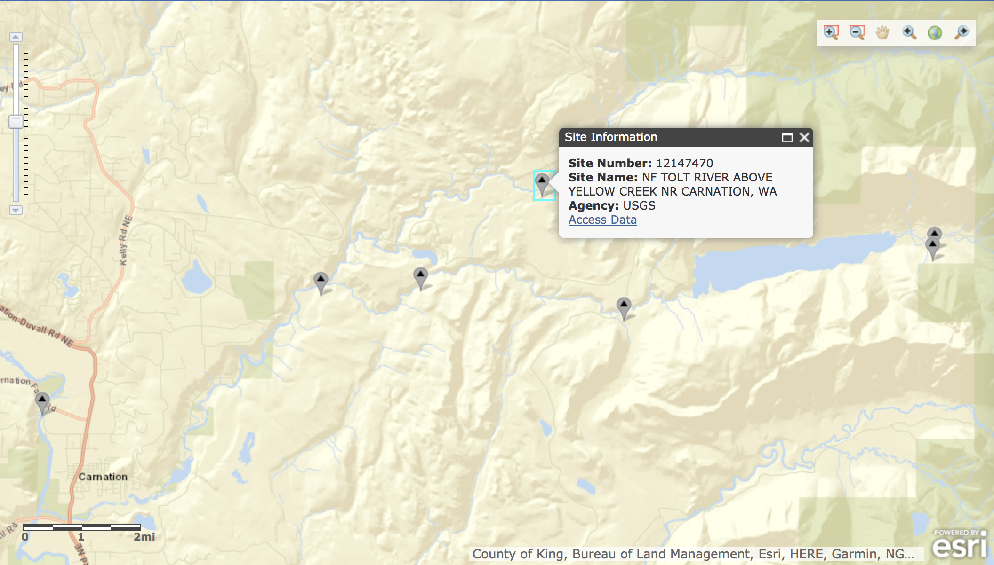
North fork stream gage
USGS 12147470 NF TOLT RIVER ABOVE YELLOW CREEK NR CARNATION, WA (has turbidity)

Slide 4
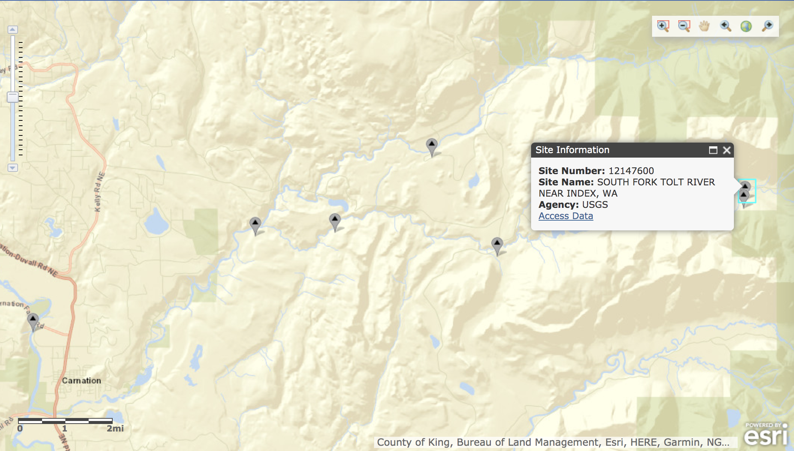
Using this stream gage for the rest of the analysis
USGS 12147600 SOUTH FORK TOLT RIVER NEAR INDEX, WA (has turbidity)

Slide 5
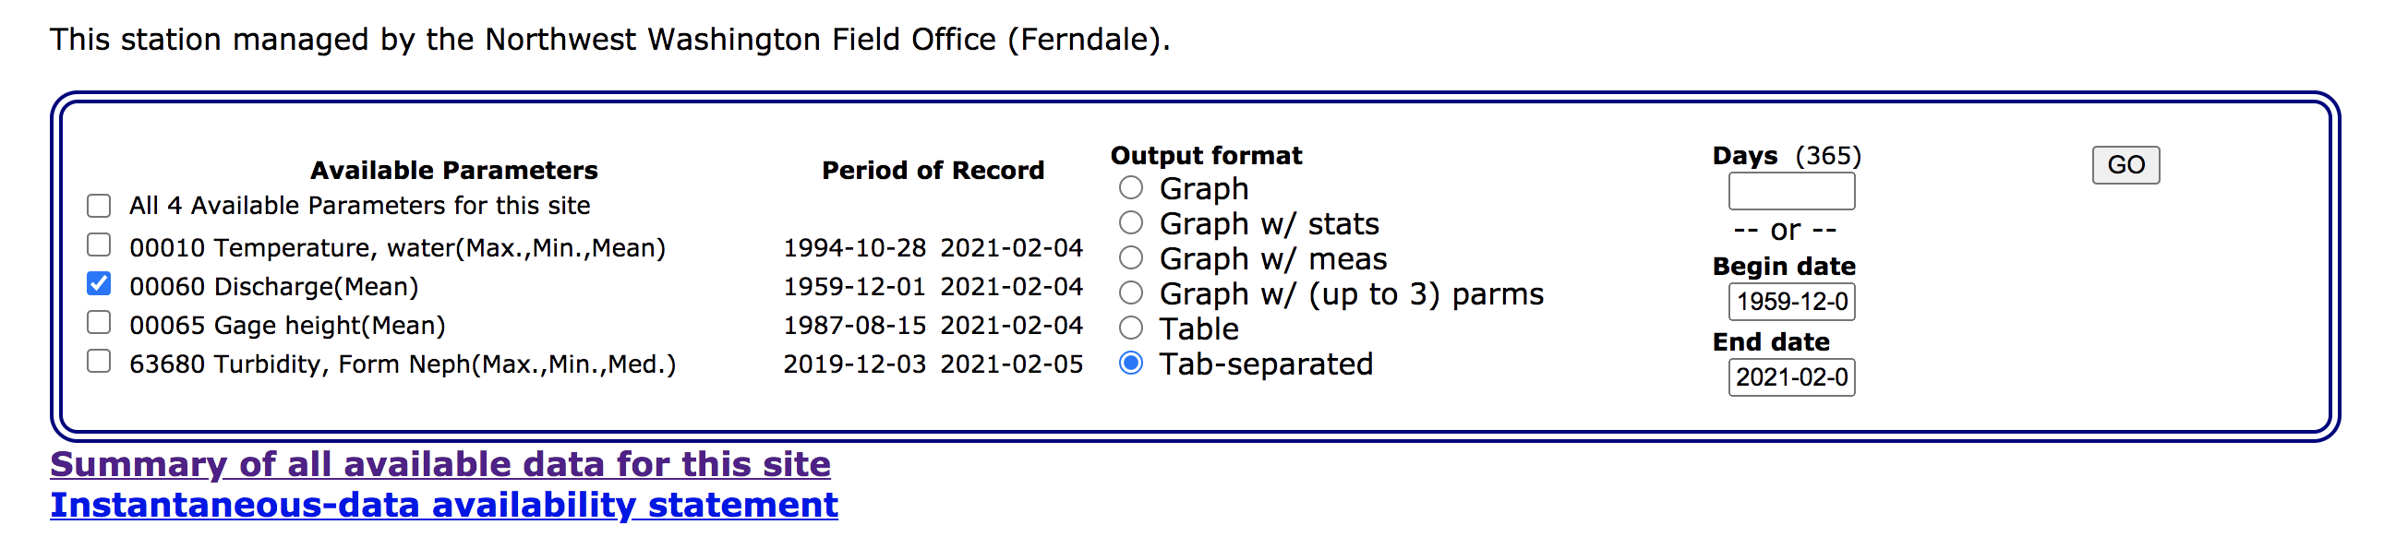
Data download
This website: https://waterdata.usgs.gov/nwis/dv?referred_module=sw&site_no=12147600
Downloaded each parameter into files for the extent of the available dates.
Doing them all together took too long
See parameters that were used for discharge as an example below
The downloaded files are saved as /path/CEWA568/final_project/data/[variable]_OG.dat (e.g. discharge_OG.dat)

Slide 6
Data download
Available dates for all datasets:

Slide 7
Units/statistic
Discharge: cubic feet per second (Mean)
Temperature: water, degrees Celsius (Maximum)
Temperature: water, degrees Celsius (Minimum)
Temperature: water, degrees Celsius (Mean)
Gage height: feet (Mean)
Turbidity: water, unfiltered, monochrome near infra-red LED light, 780-900 nm, detection angle 90 +-2.5 degrees, formazin nephelometric units (FNU) (Maximum)
Turbidity: water, unfiltered, monochrome near infra-red LED light, 780-900 nm, detection angle 90 +-2.5 degrees, formazin nephelometric units (FNU) (Minimum)
Turbidity: water, unfiltered, monochrome near infra-red LED light, 780-900 nm, detection angle 90 +-2.5 degrees, formazin nephelometric units (FNU) (Median)

Slide 8
Combined file with all of the data
Combination commands are listed in the script:
/[Path]/CEWA568/final_project/data/combine_datasets.py
The combined file is in :
/[Path]/CEWA568/final_project/data/all_data_12147600.csv
The script renames the columns to be more meaningful for quick analysis, and combines them by dates to be in the same file
Column names and first row:
(uwresearch) Ginevras-MBP-2:data ginevramoore$ vi all_data_12147600.csv
datetime,mean_discharge,mean_discharge_cd,mean_gageheight,mean_gageheight_cd,max_temp,max_temp_cd,min_temp,min_temp_cd,mean_temp,mean_temp_cd,max_turbidity,max_turbidity_cd,min_turbidity,min_turbidity_cd,med_turbidity,med_turbidity_cd
1959-12-01,90.0,A,nan,nan,nan,nan,nan,nan,nan,nan,nan,nan,nan,nan,nan,nan
Everything is nan except for the mean discharge and the quality ([variable]_cd column)

Slide 9
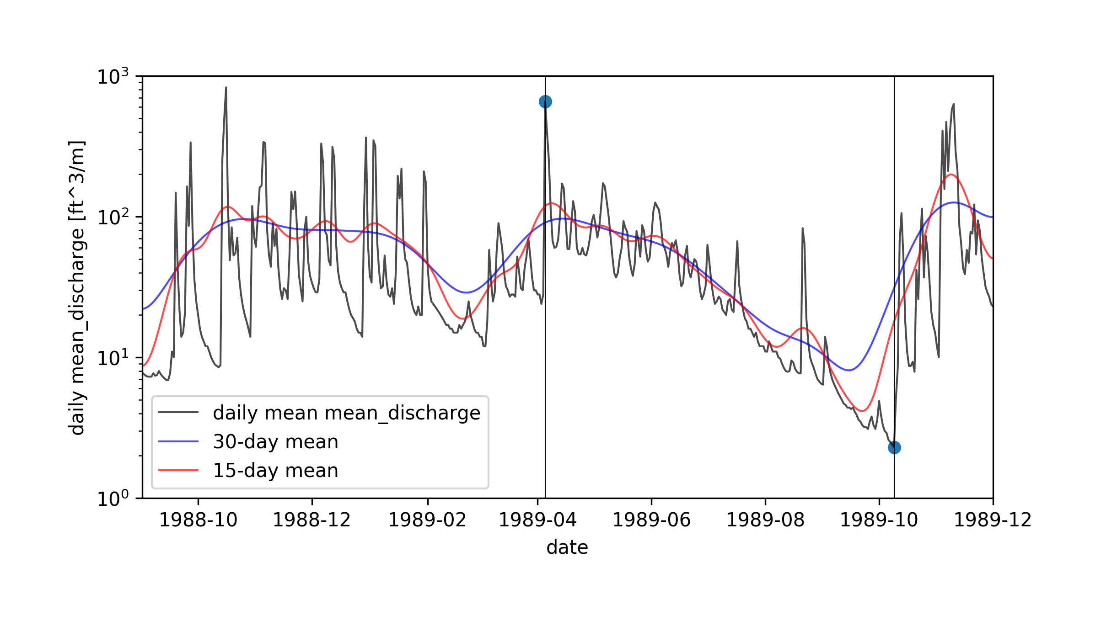
plotting
Use this script to run all of the years available for this site:
/path/CEWA568/final_project/processing/plot_all_years_individually.py
It calls: /path/CEWA568/final_project/processing/plotyear.py
See arguments in notes for example of plotyear.py
Plotting these minimum/maximum values on the next slide
Notes:
python plotyear.py -infile /Users/ginevramoore/Desktop/CEWA568/final_project/data/all_data_12147600.csv -op water_years/12147600_09.01.88-12.01.89.png -b 09.01.88 12.01.89 -p1dm y -p15dm y -p30dm y -c1 mean_discharge -u1 [ft^3/m]

Slide 10
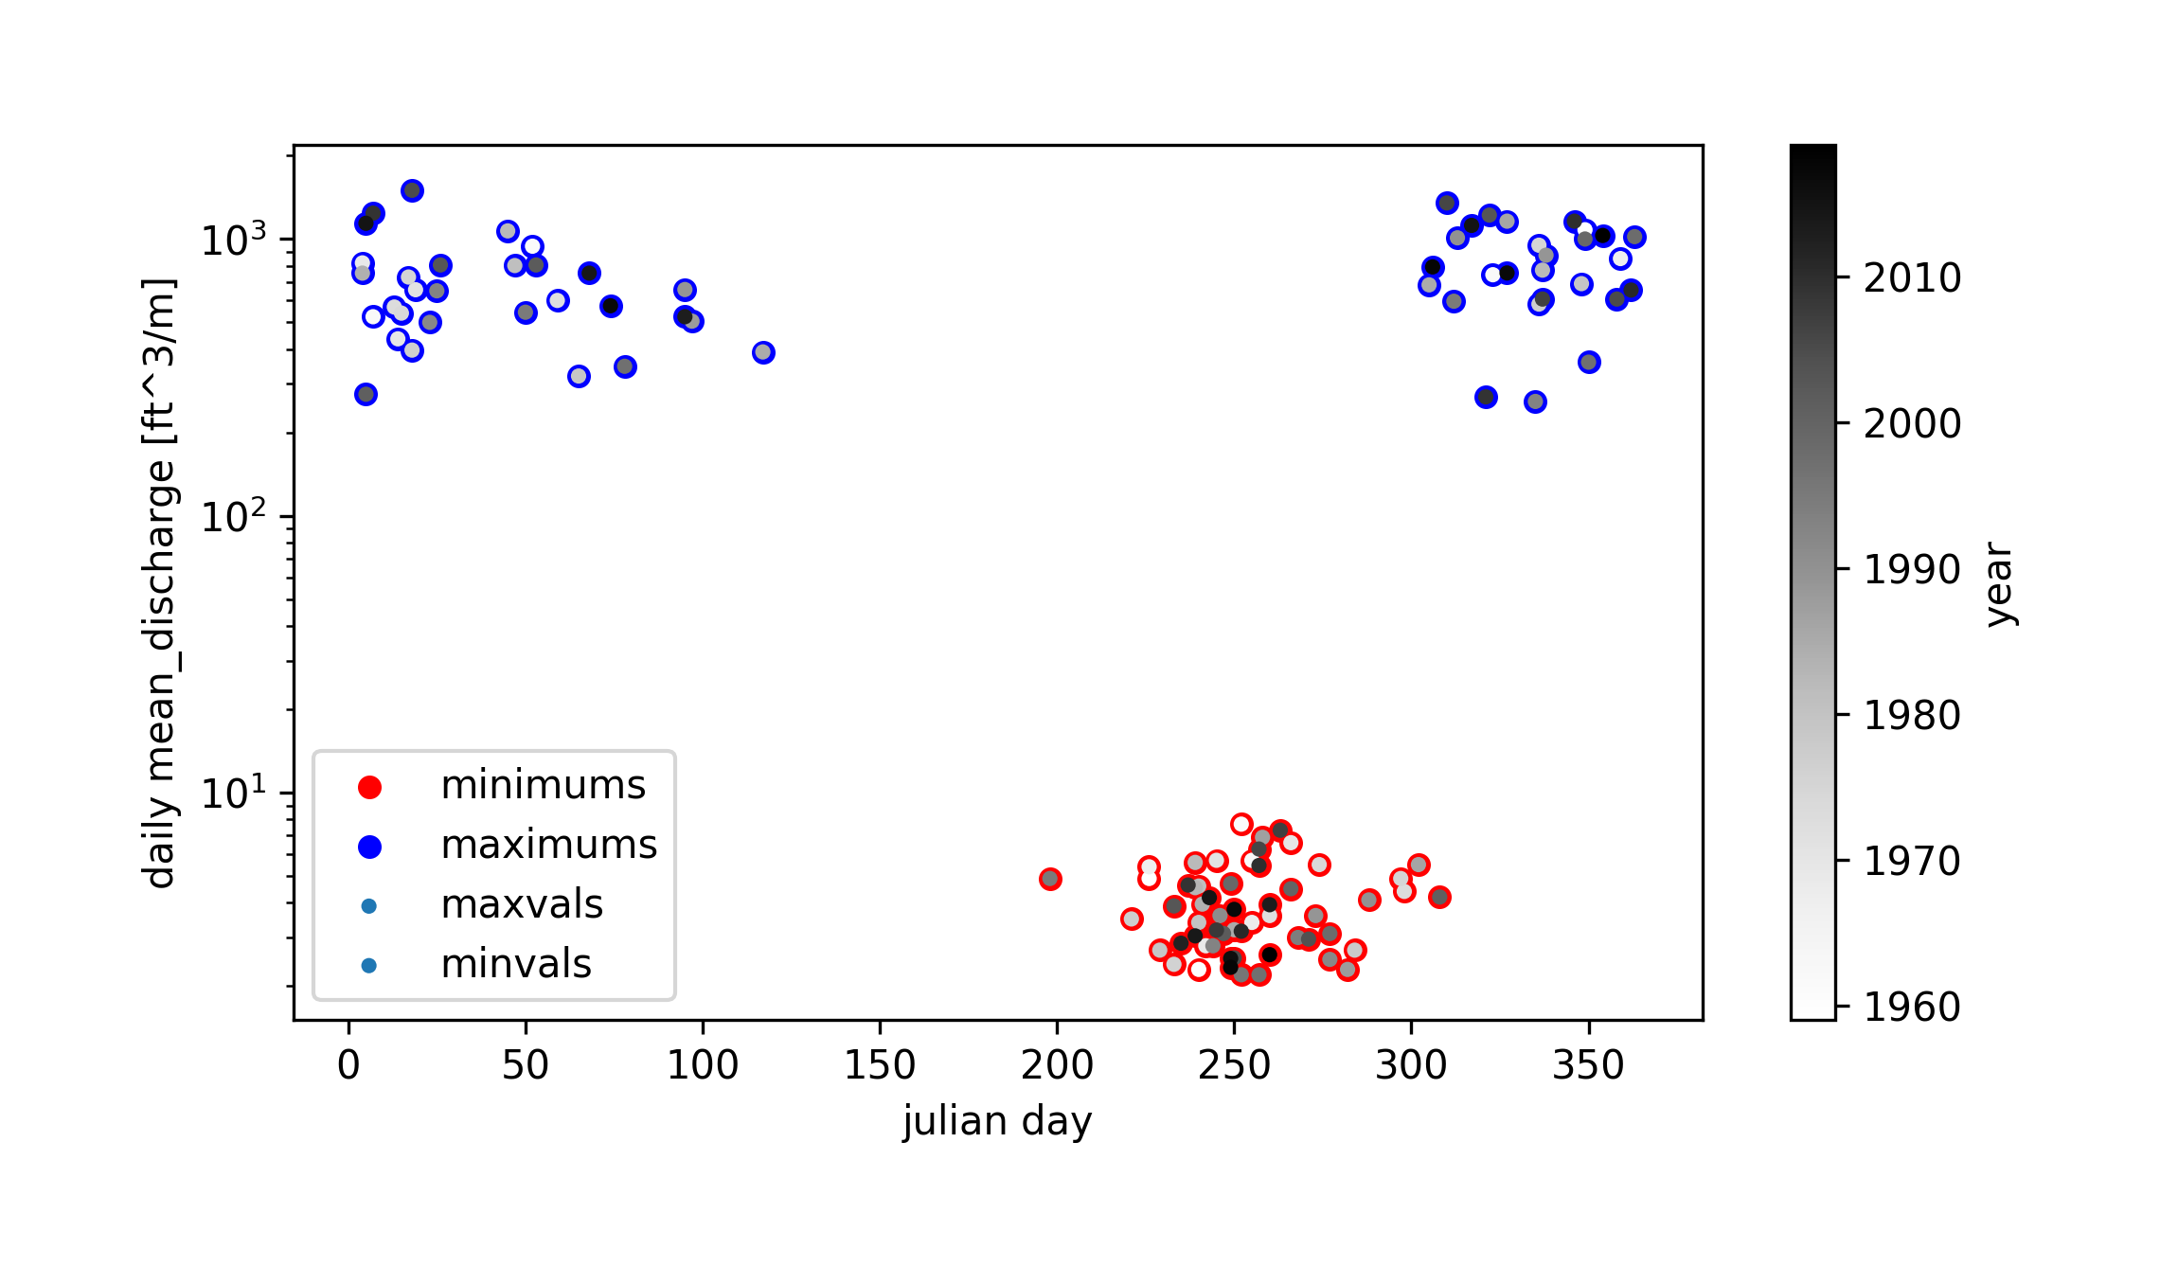
Plotting mins and maxs to see if there is a trend in the timing or magnitude of these values
Notes:
python getminmax.py -op minmaxs/09.01.1959-12.01.2020.png -infile_stream /Users/ginevramoore/Desktop/CEWA568/final_project/data/all_data_12147600.csv -infile_snotel ../data/skookum_snotel.csv -b 09.01.1959 12.01.2020 -c1 mean_discharge -u1 [ft^3/m]

Slide 11
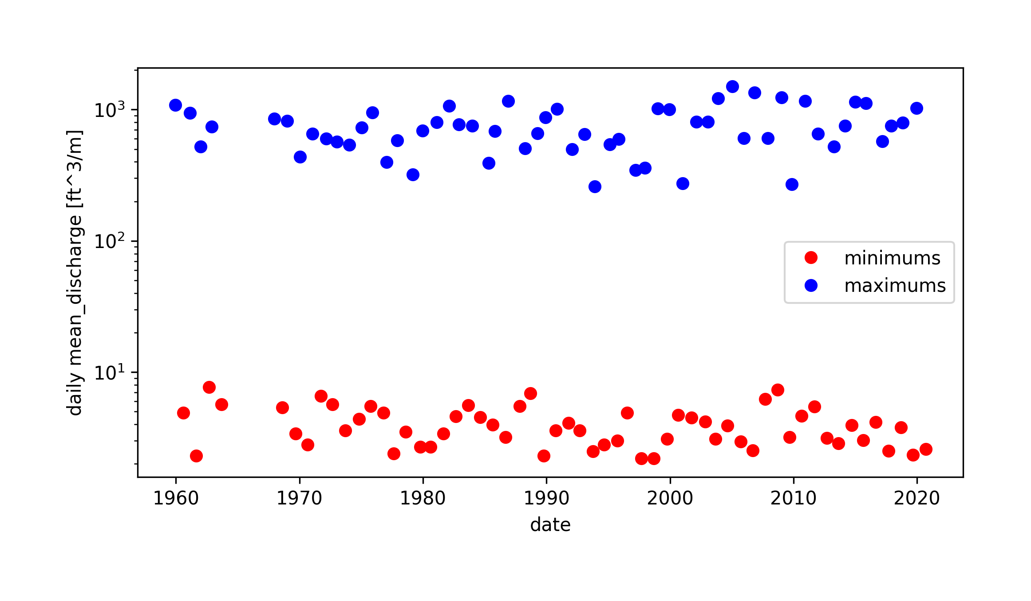
Plotting mins and maxs to see if there is a trend in the timing or magnitude of these values
Notes:
python getminmax.py -op minmaxs/09.01.1959-12.01.2020.png -infile_stream /Users/ginevramoore/Desktop/CEWA568/final_project/data/all_data_12147600.csv -infile_snotel ../data/skookum_snotel.csv -b 09.01.1959 12.01.2020 -c1 mean_discharge -u1 [ft^3/m]

Slide 12
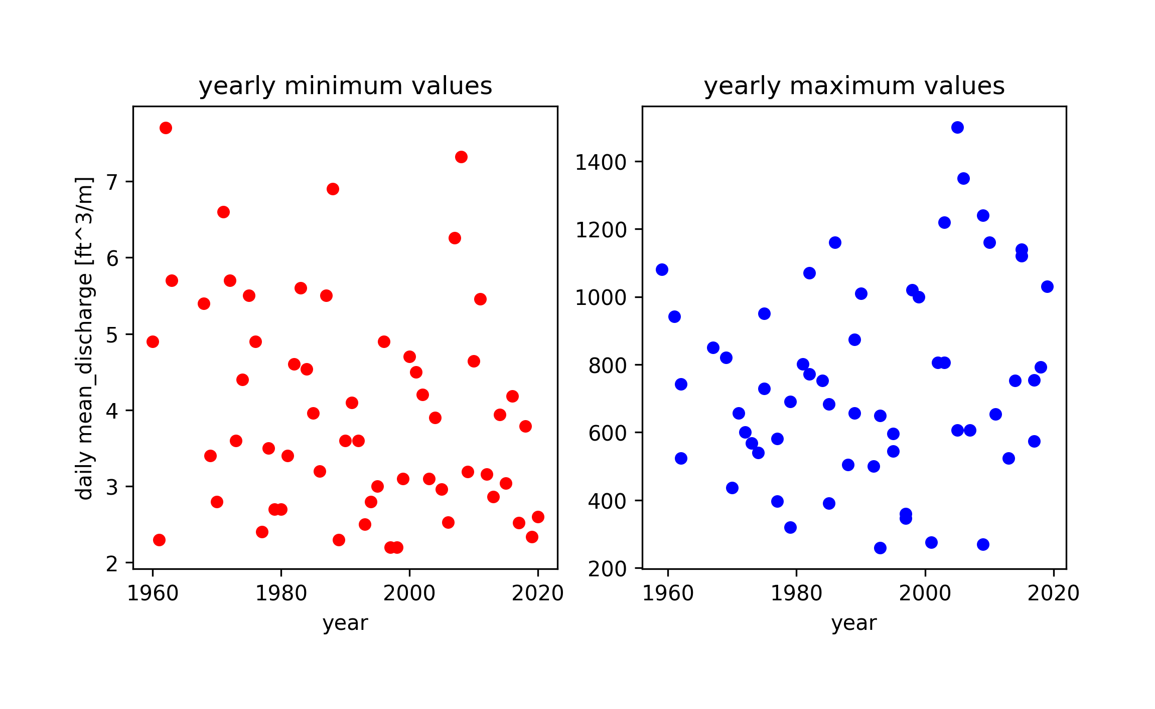
Plotting mins and maxs to see if there is a trend in the timing or magnitude of these values
Notes:
python getminmax.py -op minmaxs/09.01.1959-12.01.2020.png -infile_stream /Users/ginevramoore/Desktop/CEWA568/final_project/data/all_data_12147600.csv -infile_snotel ../data/skookum_snotel.csv -b 09.01.1959 12.01.2020 -c1 mean_discharge -u1 [ft^3/m]

Slide 13
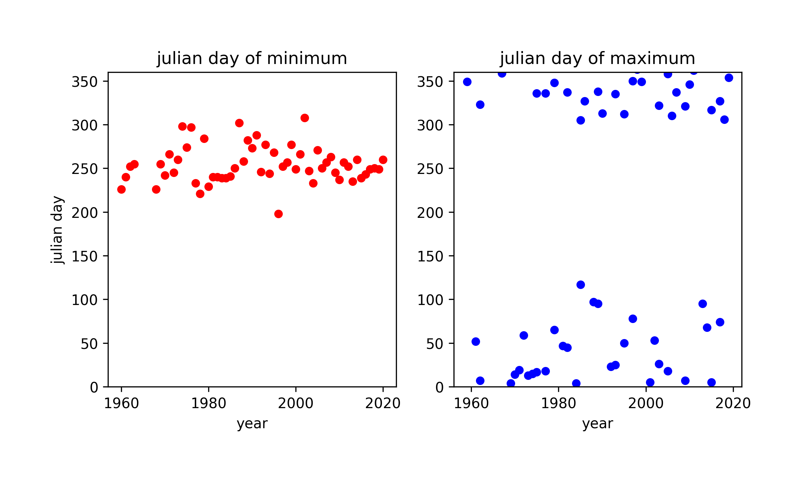
Plotting mins and maxs to see if there is a trend in the timing or magnitude of these values
Notes:
python getminmax.py -op minmaxs/09.01.1959-12.01.2020.png -infile_stream /Users/ginevramoore/Desktop/CEWA568/final_project/data/all_data_12147600.csv -infile_snotel ../data/skookum_snotel.csv -b 09.01.1959 12.01.2020 -c1 mean_discharge -u1 [ft^3/m]

Slide 14
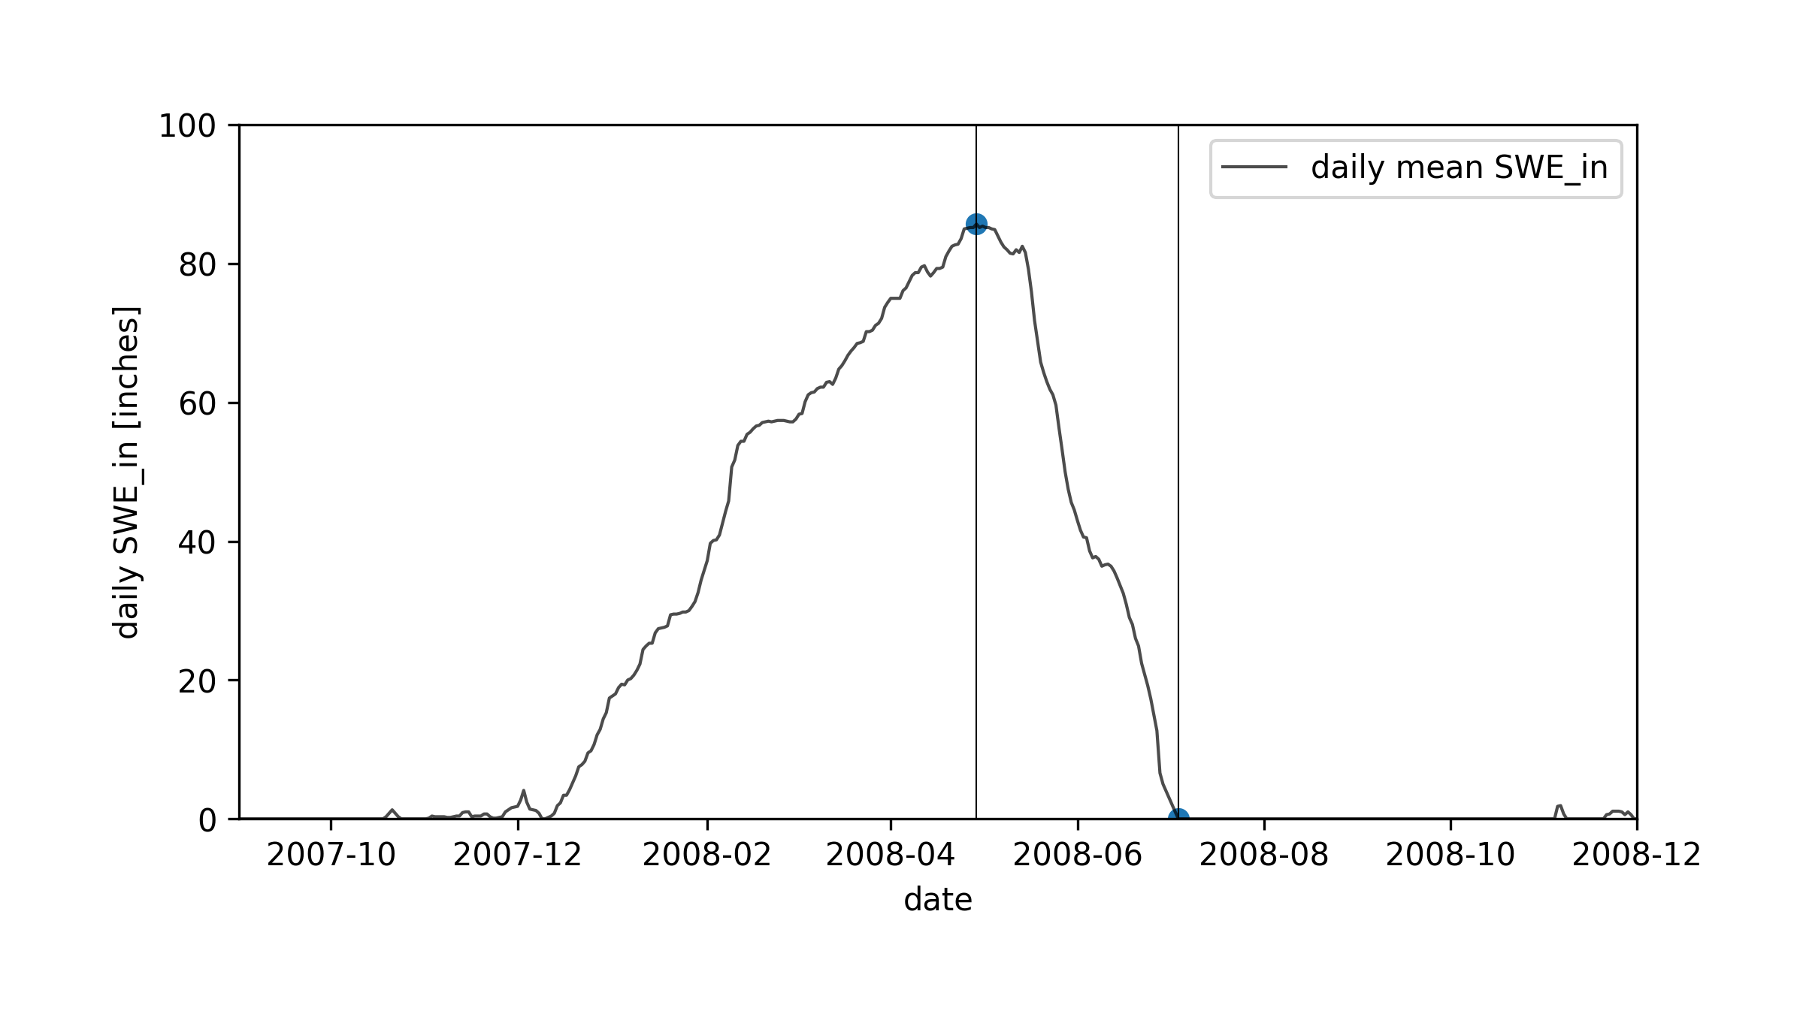
plotting
Use this script to run all of the years available for this site:
/path/CEWA568/final_project/processing/plot_all_years_individually.py
It calls: /path/CEWA568/final_project/processing/plotyear.py
See arguments in notes for example of plotyear.py
Plotting these minimum/maximum values on the next slide
Notes:
("python plotyear.py -infile_stream /Users/ginevramoore/Desktop/CEWA568/final_project/data/all_data_12147600.csv -op water_years/12147600_09.01.%s-12.01.%s.png -b 09.01.%s 12.01.%s -p1dm y -p15dm y -p30dm y -c1 mean_discharge -u1 [ft^3/m]" % (startyear, endyear, startyear, endyear))

Slide 15
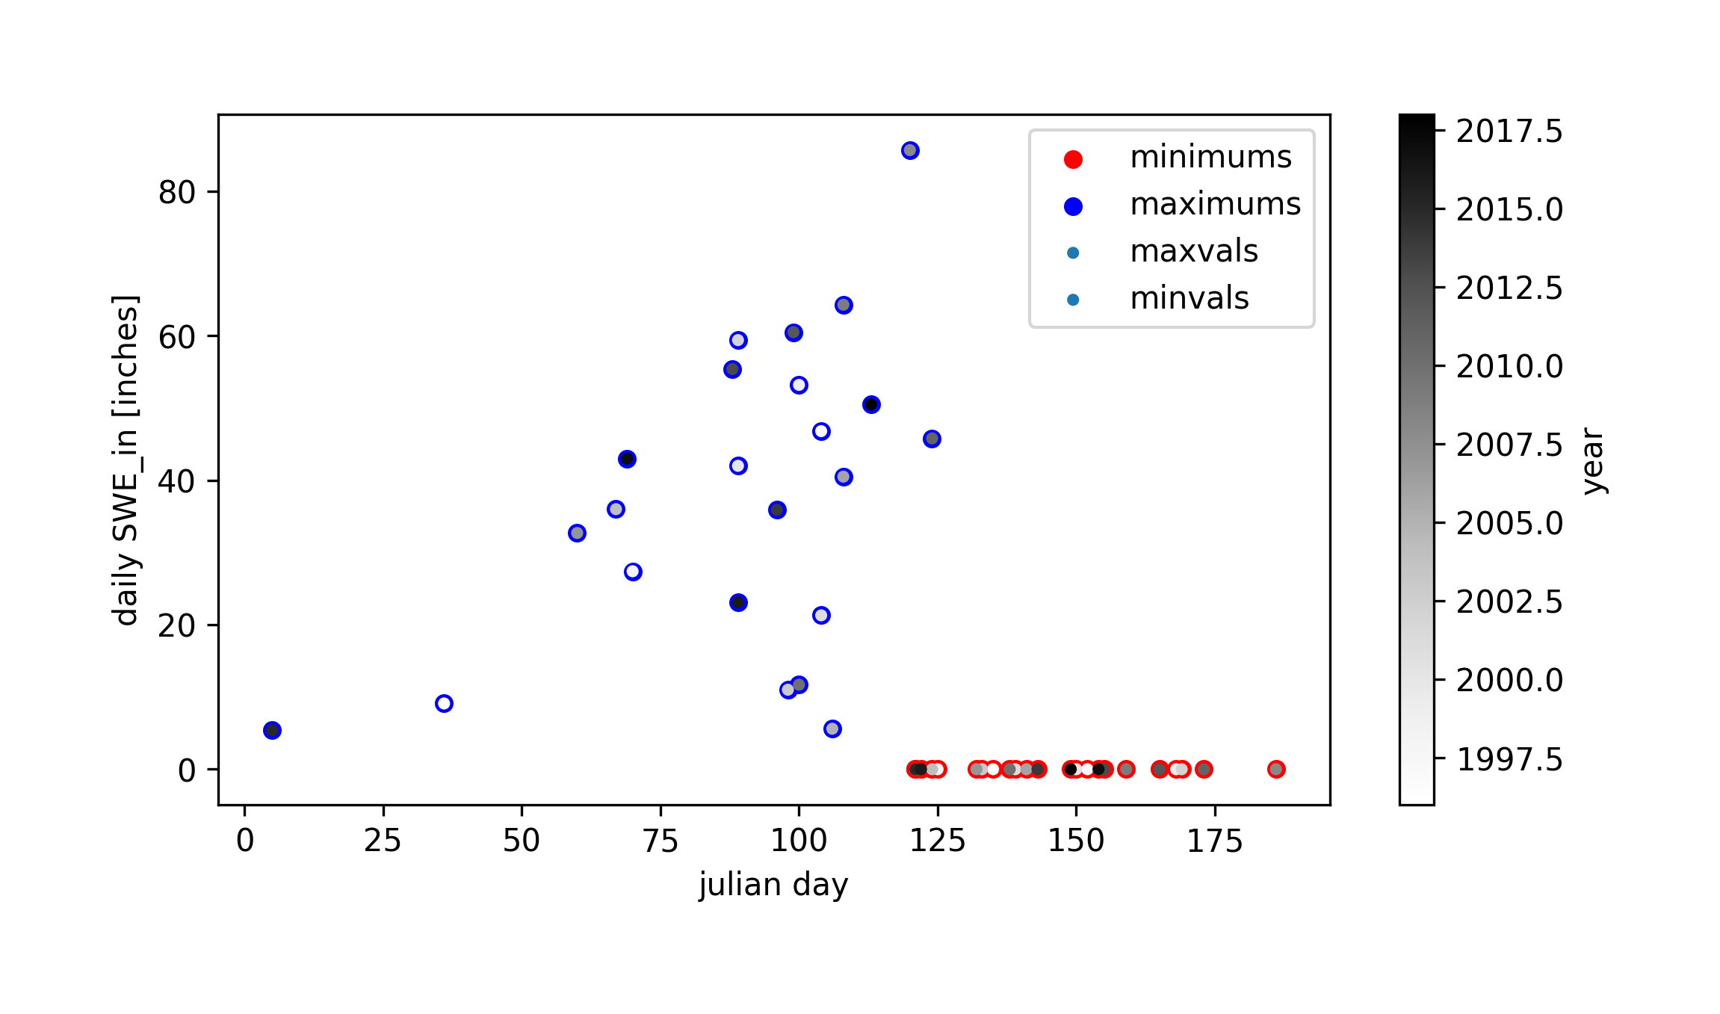
Plotting mins and maxs to see if there is a trend in the timing or magnitude of these values
Notes:
python getminmax.py -op minmaxs/09.01.1995-12.01.2020.png -infile_stream /Users/ginevramoore/Desktop/CEWA568/final_project/data/all_data_12147600.csv -infile_snotel ../data/skookum_snotel.csv -b 09.01.1995 12.01.2020 -c1 SWE_in -u1 [inches] -nl y

Slide 16
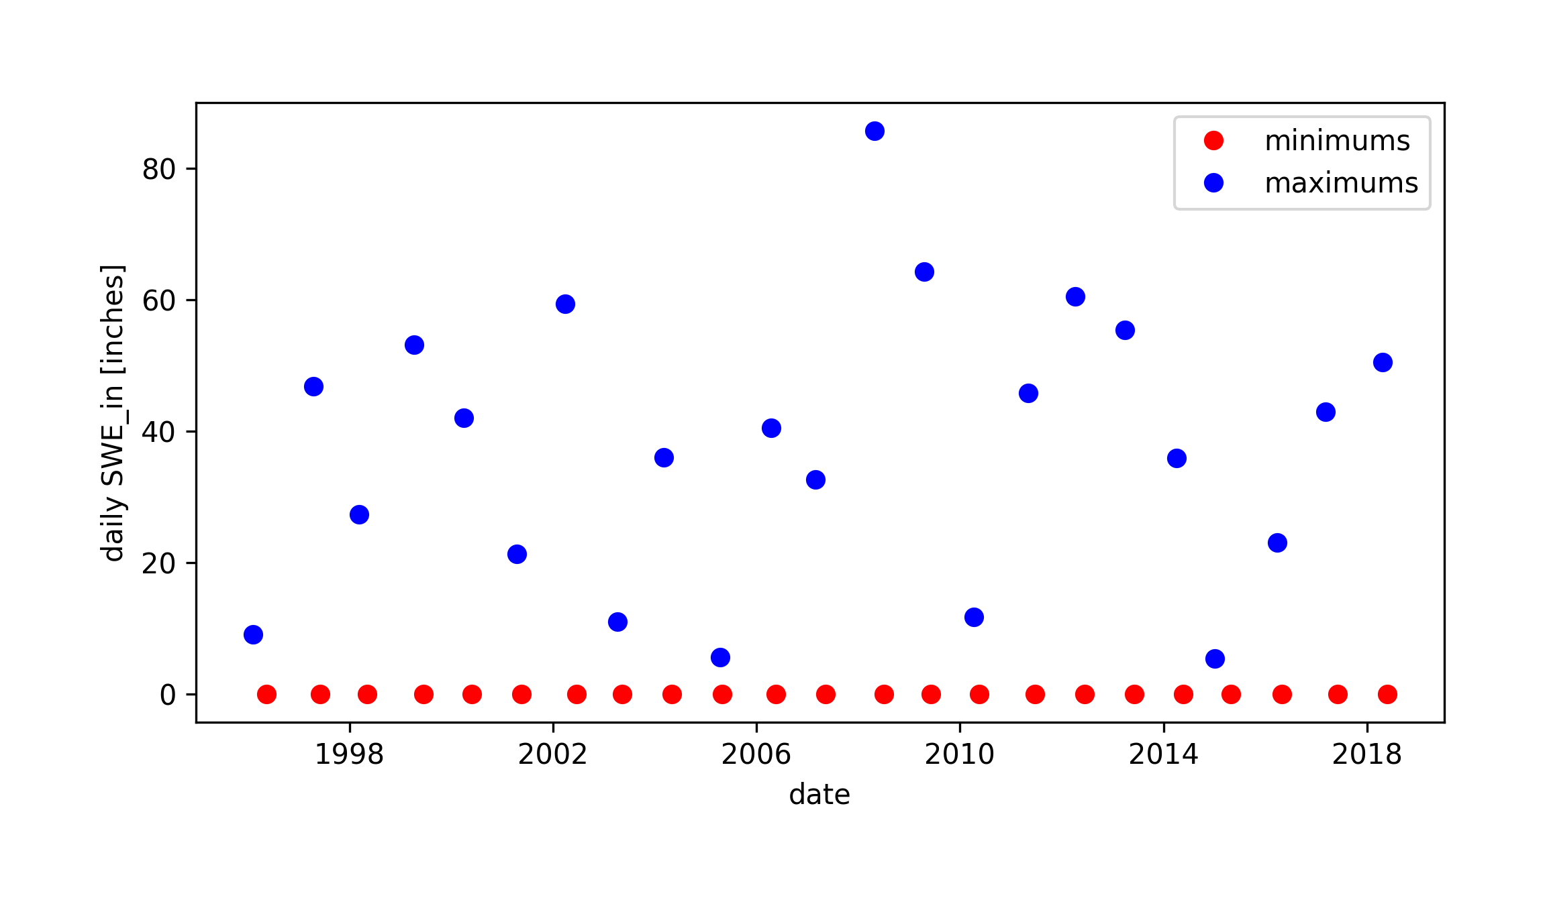
Plotting mins and maxs to see if there is a trend in the timing or magnitude of these values
Notes:
python getminmax.py -op minmaxs/09.01.1995-12.01.2020.png -infile_stream /Users/ginevramoore/Desktop/CEWA568/final_project/data/all_data_12147600.csv -infile_snotel ../data/skookum_snotel.csv -b 09.01.1995 12.01.2020 -c1 SWE_in -u1 [inches] -nl y

Slide 17
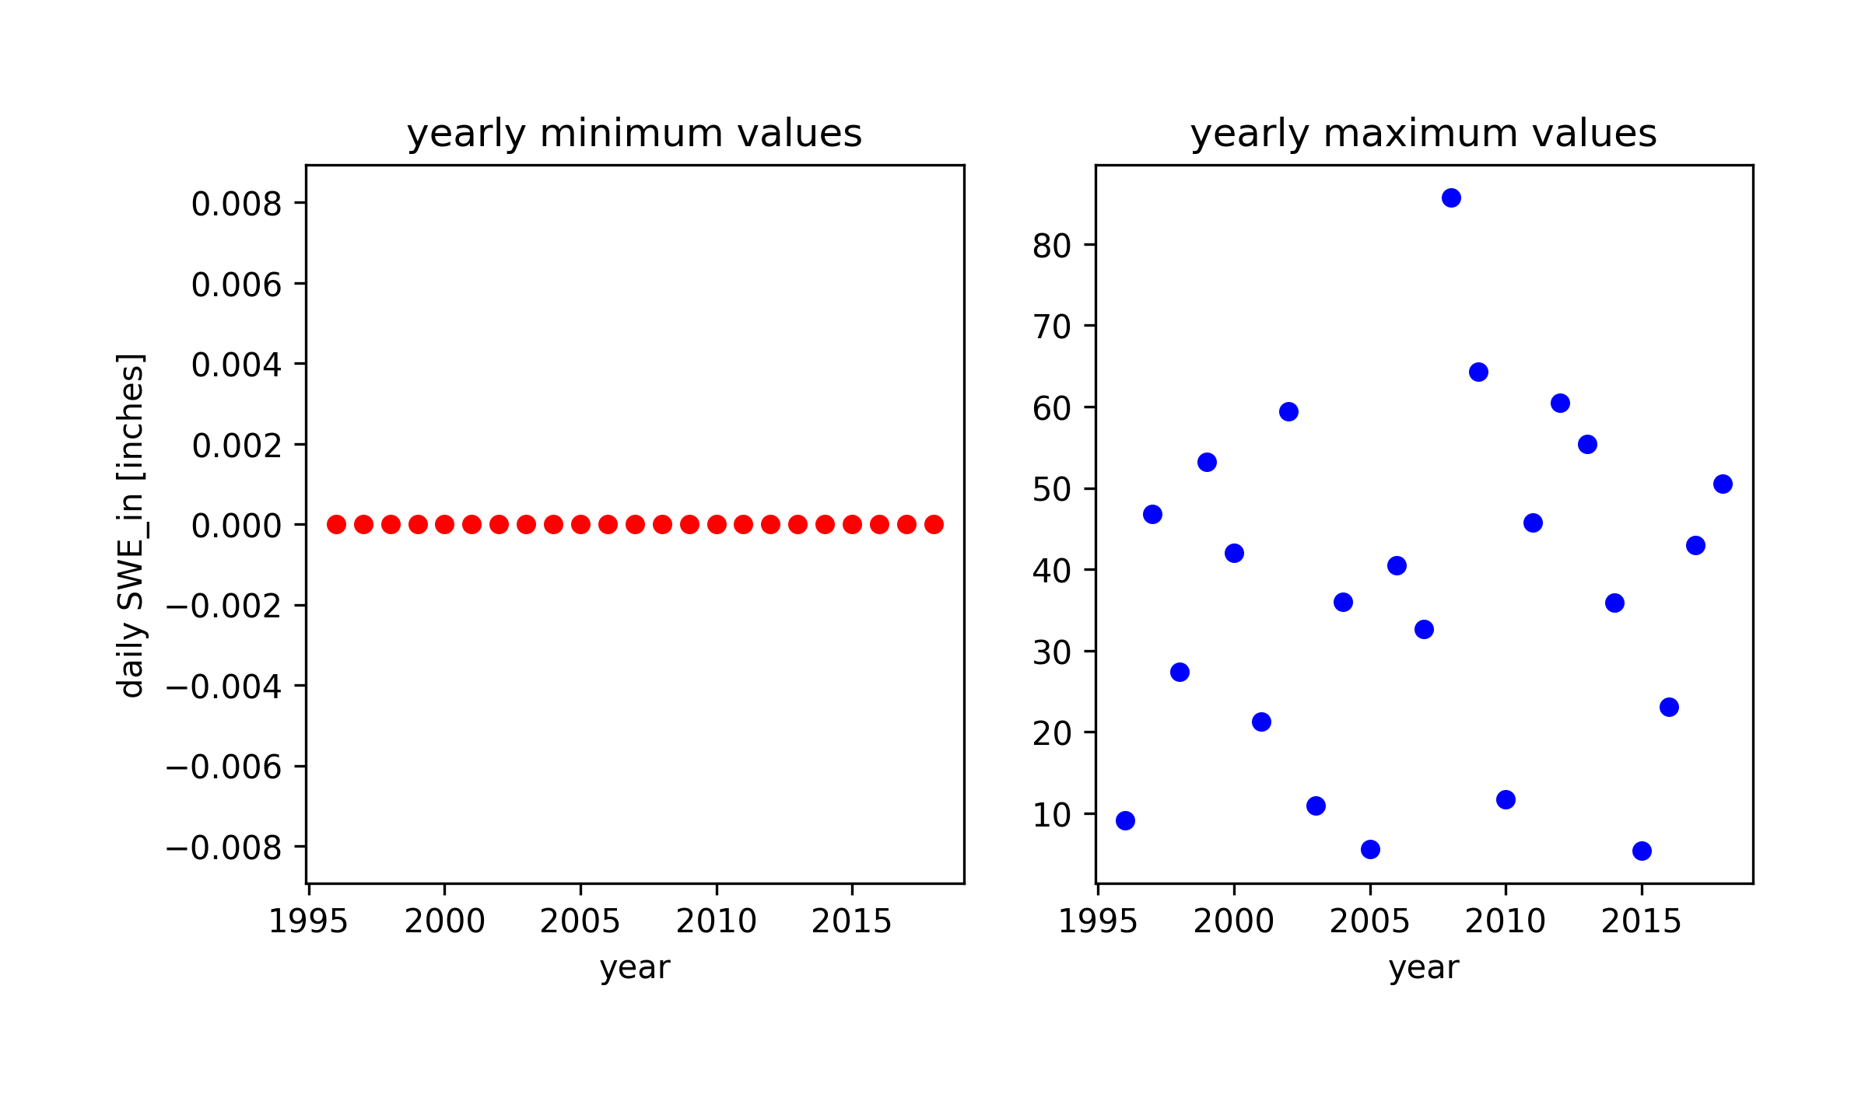
Plotting mins and maxs to see if there is a trend in the timing or magnitude of these values
Notes:
python getminmax.py -op minmaxs/09.01.1995-12.01.2020.png -infile_stream /Users/ginevramoore/Desktop/CEWA568/final_project/data/all_data_12147600.csv -infile_snotel ../data/skookum_snotel.csv -b 09.01.1995 12.01.2020 -c1 SWE_in -u1 [inches] -nl y

Slide 18
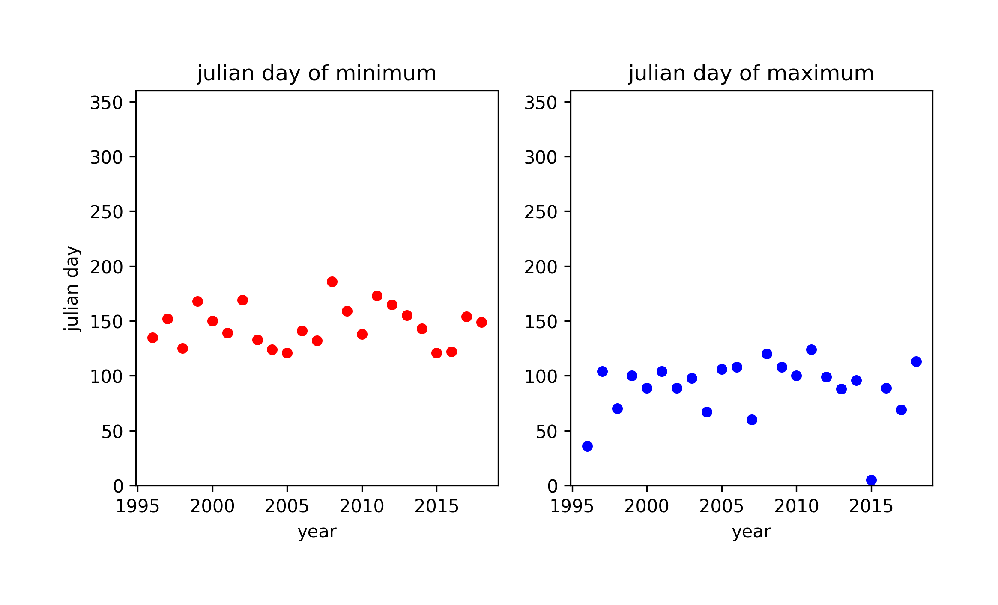
Plotting mins and maxs to see if there is a trend in the timing or magnitude of these values
Notes:
python getminmax.py -op minmaxs/09.01.1995-12.01.2020.png -infile_stream /Users/ginevramoore/Desktop/CEWA568/final_project/data/all_data_12147600.csv -infile_snotel ../data/skookum_snotel.csv -b 09.01.1995 12.01.2020 -c1 SWE_in -u1 [inches] -nl y

Slide 19
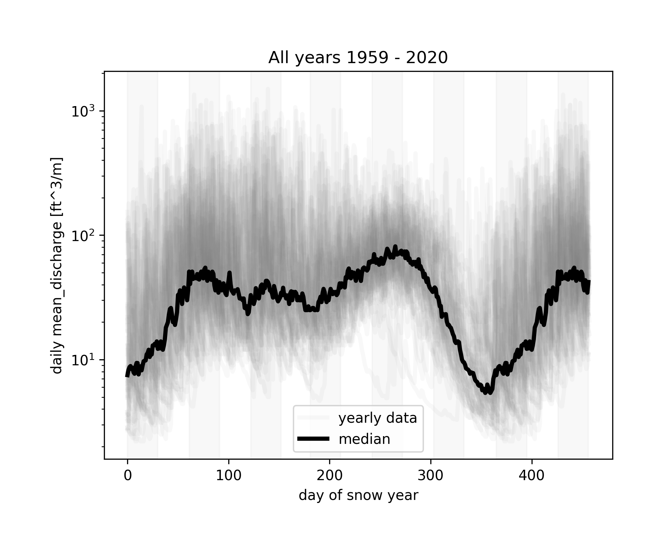
S
O
N
D
J
F
M
A
M
J
J
A
S
O
N
Notes:
python getminmax.py -op minmaxs/09.01.1959-12.01.2020.png -infile_stream /Users/ginevramoore/Desktop/CEWA568/final_project/data/all_data_12147600.csv -infile_snotel ../data/skookum_snotel.csv -b 09.01.1959 12.01.2020 -c1 mean_discharge -u1 [ft^3/m]

Slide 20
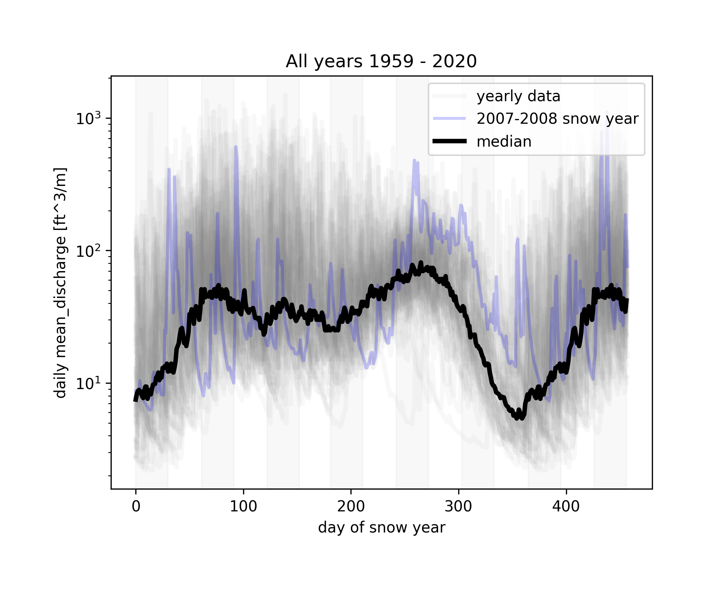
S
O
N
D
J
F
M
A
M
J
J
A
S
O
N
Notes:
python getminmax.py -op minmaxs/09.01.1959-12.01.2020.png -infile_stream /Users/ginevramoore/Desktop/CEWA568/final_project/data/all_data_12147600.csv -infile_snotel ../data/skookum_snotel.csv -b 09.01.1959 12.01.2020 -c1 mean_discharge -u1 [ft^3/m] -plothighyear y

Slide 21
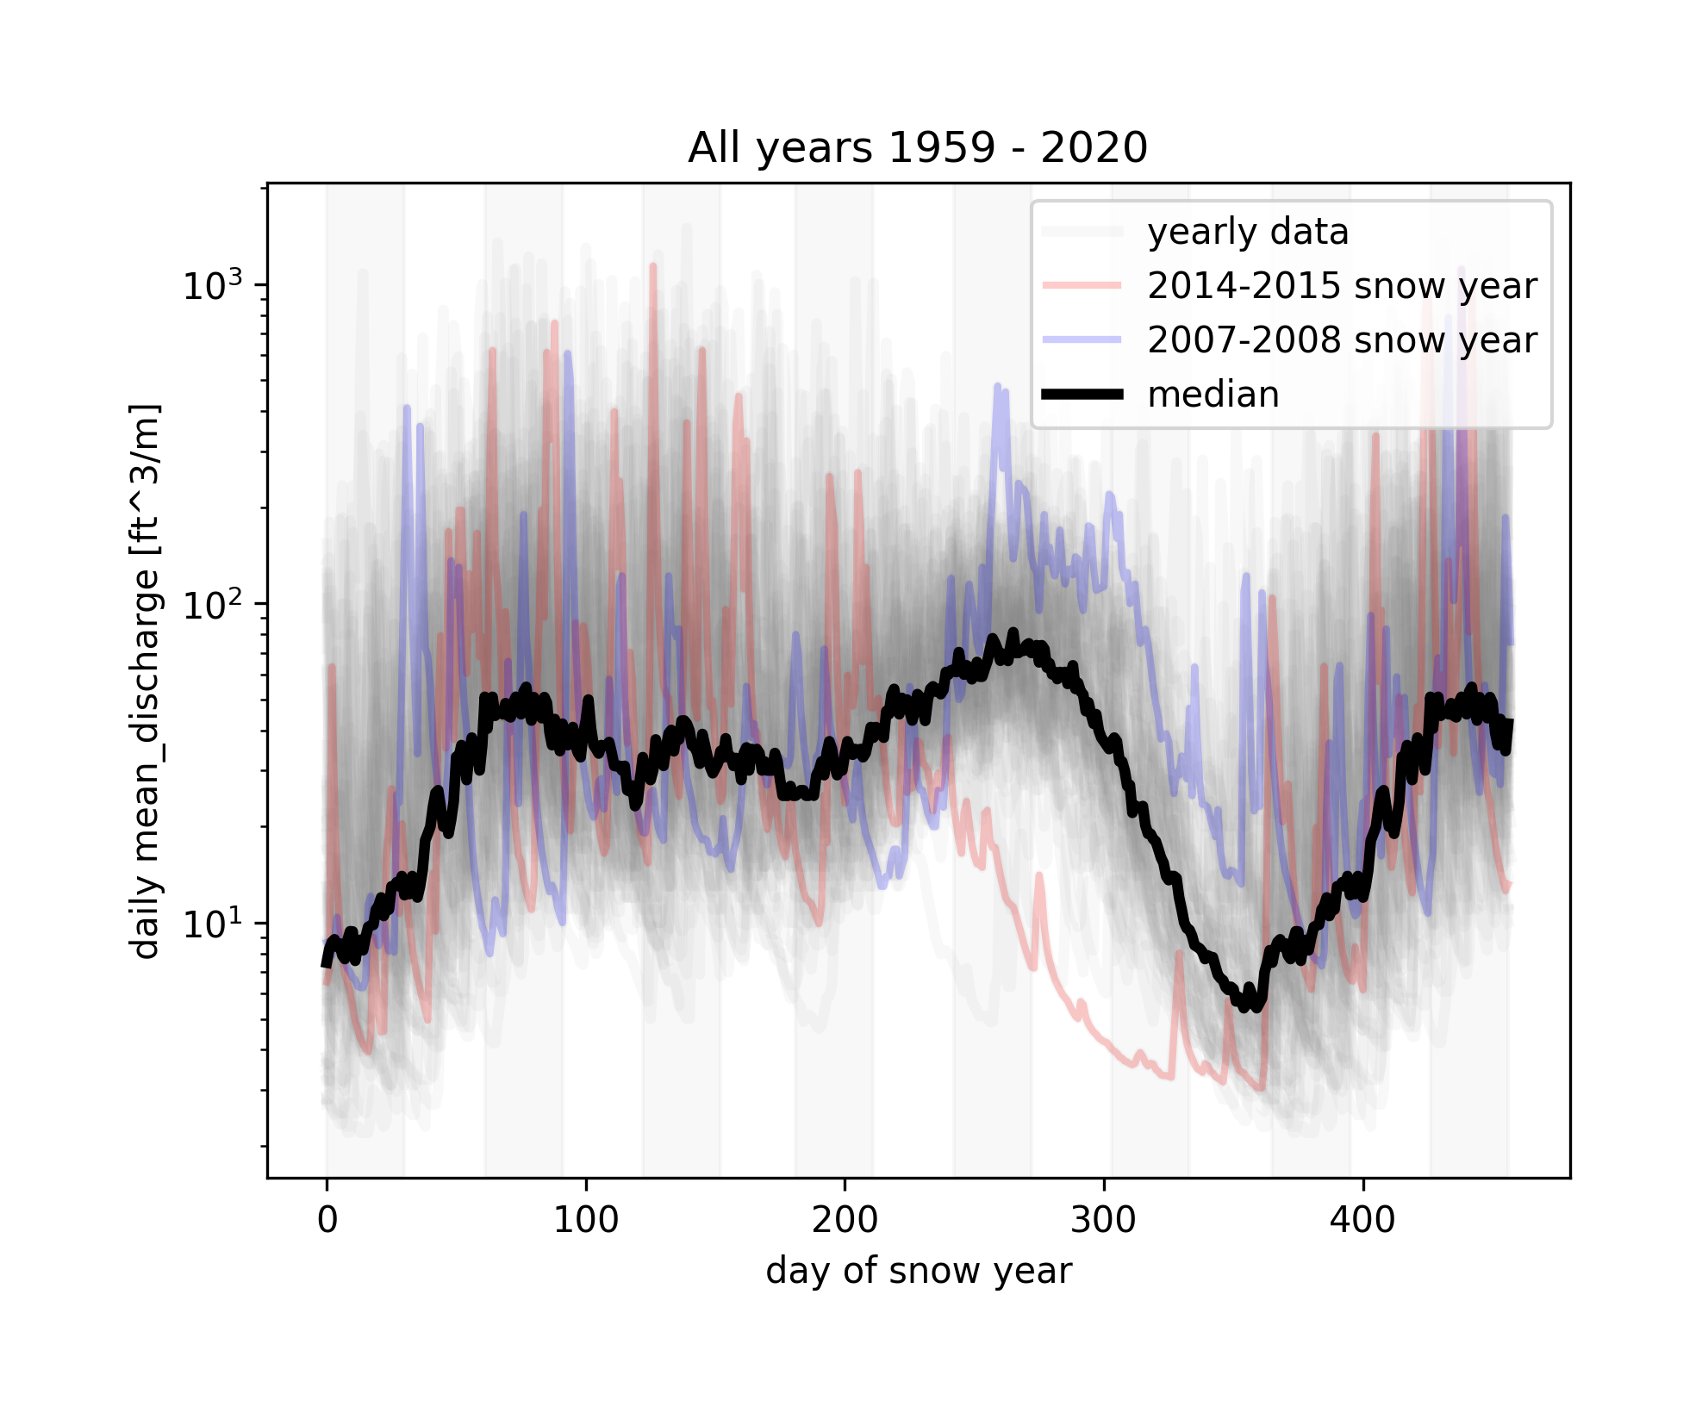
S
O
N
D
J
F
M
A
M
J
J
A
S
O
N
Notes:
python getminmax.py -op minmaxs/09.01.1959-12.01.2020.png -infile_stream /Users/ginevramoore/Desktop/CEWA568/final_project/data/all_data_12147600.csv -infile_snotel ../data/skookum_snotel.csv -b 09.01.1959 12.01.2020 -c1 mean_discharge -u1 [ft^3/m] -plothighyear y -plotlowyear y

Slide 22
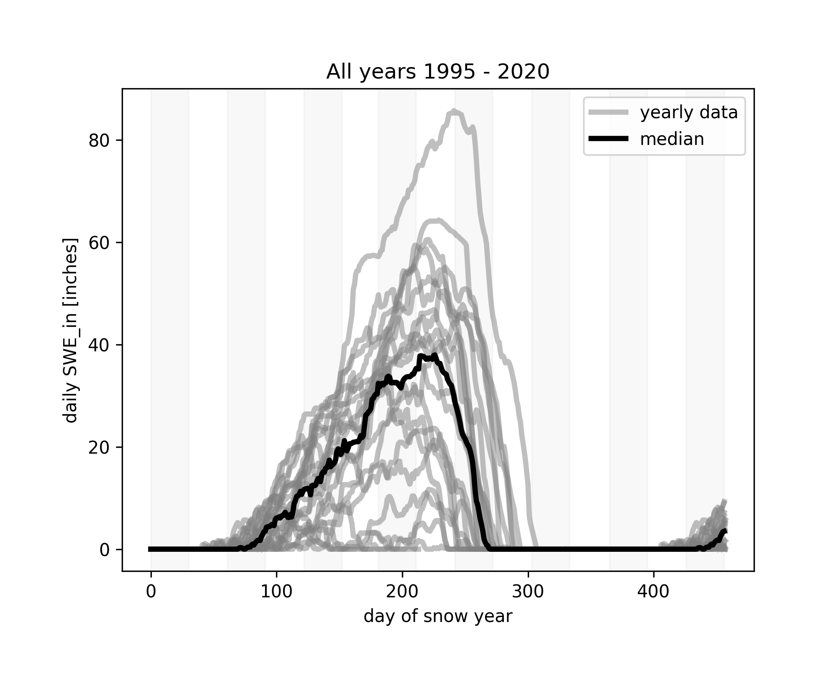
S
O
N
D
J
F
M
A
M
J
J
A
S
O
N
Notes:
python getminmax.py -op minmaxs/09.01.1995-12.01.2020.png -infile_stream /Users/ginevramoore/Desktop/CEWA568/final_project/data/all_data_12147600.csv -infile_snotel ../data/skookum_snotel.csv -b 09.01.1995 12.01.2020 -c1 SWE_in -u1 [inches] -nl y

Slide 23
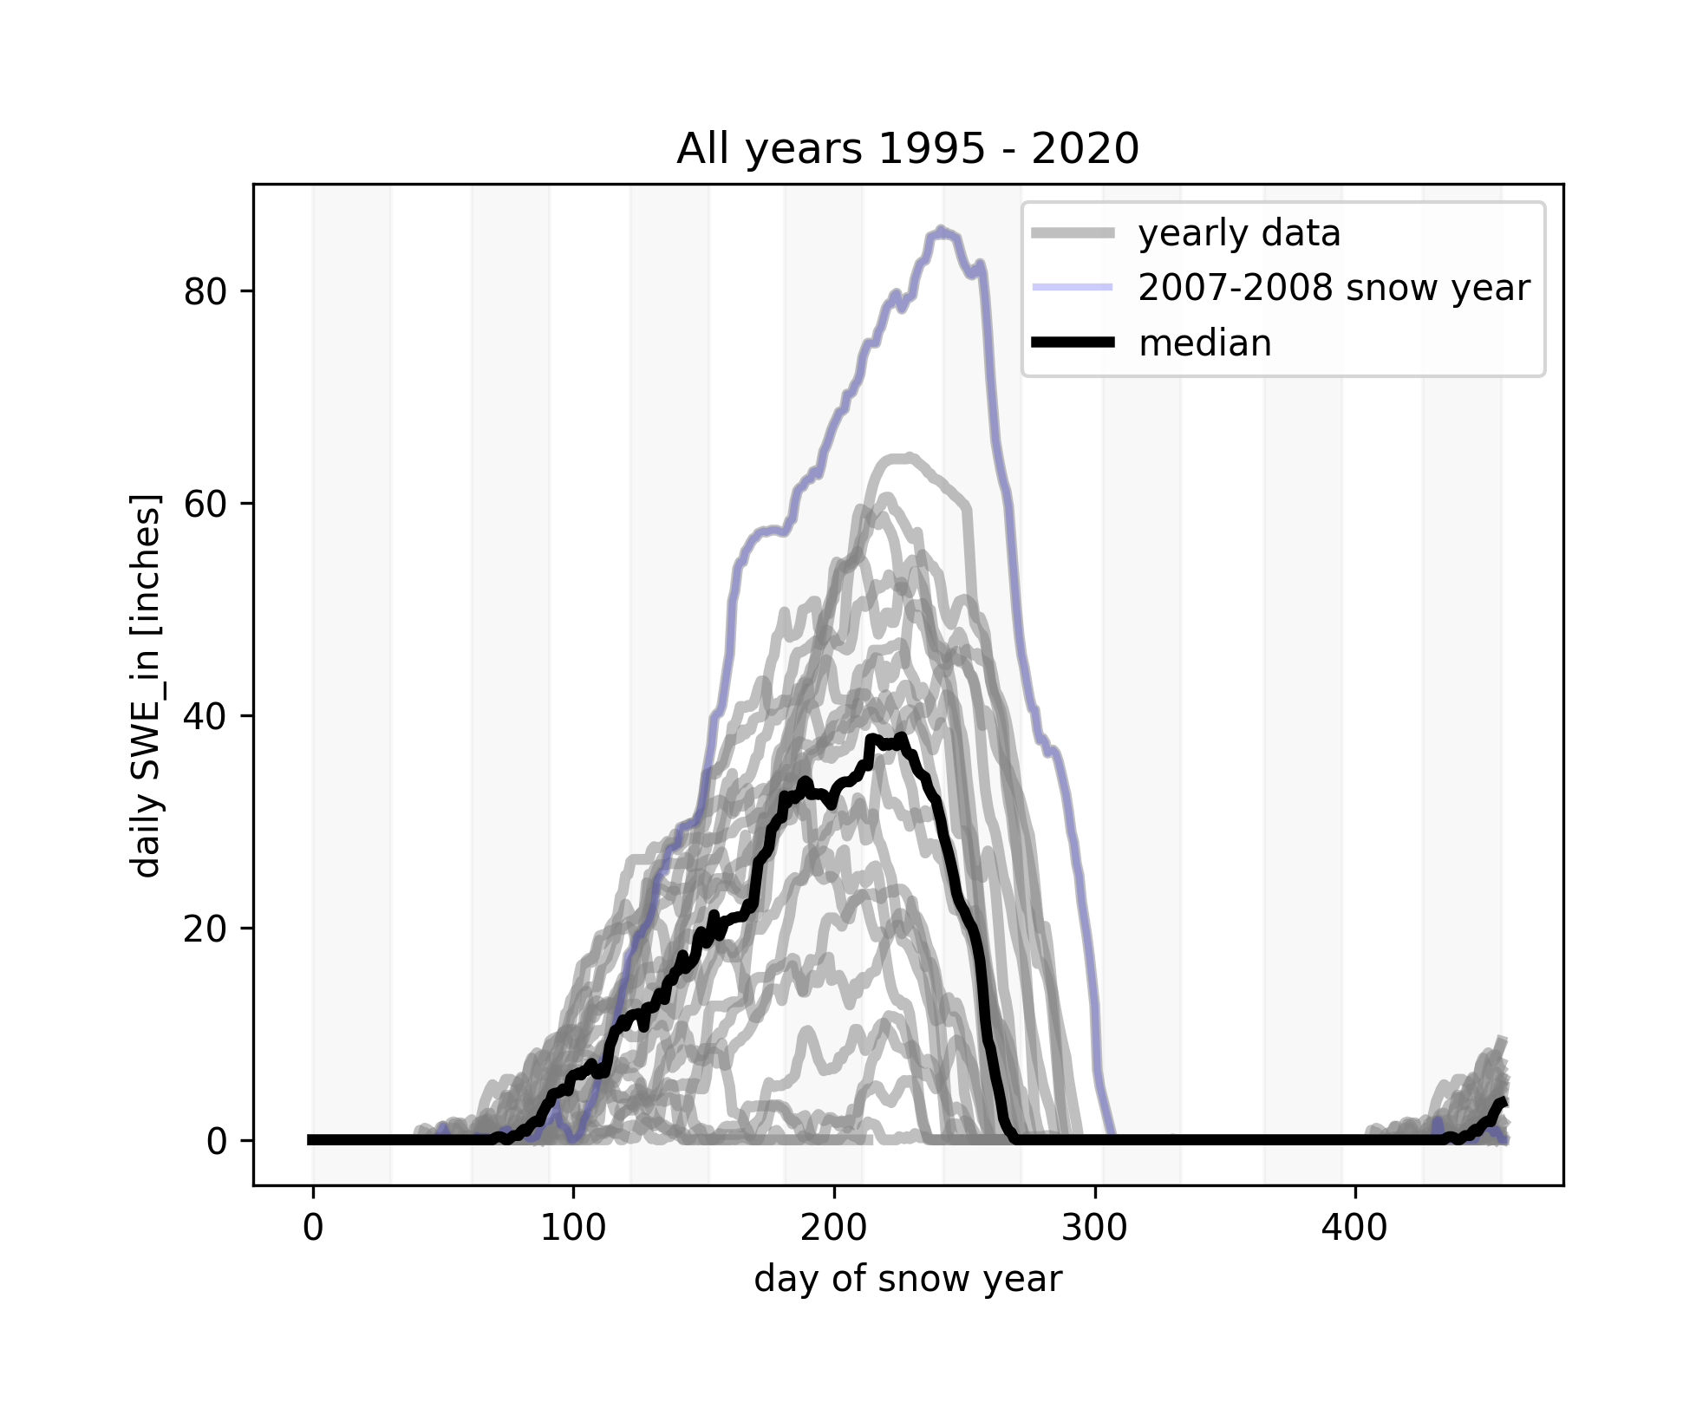
S
O
N
D
J
F
M
A
M
J
J
A
S
O
N
Notes:
python getminmax.py -op minmaxs/09.01.1995-12.01.2020.png -infile_stream /Users/ginevramoore/Desktop/CEWA568/final_project/data/all_data_12147600.csv -infile_snotel ../data/skookum_snotel.csv -b 09.01.1995 12.01.2020 -c1 SWE_in -u1 [inches] -nl y -plothighyear y

Slide 24
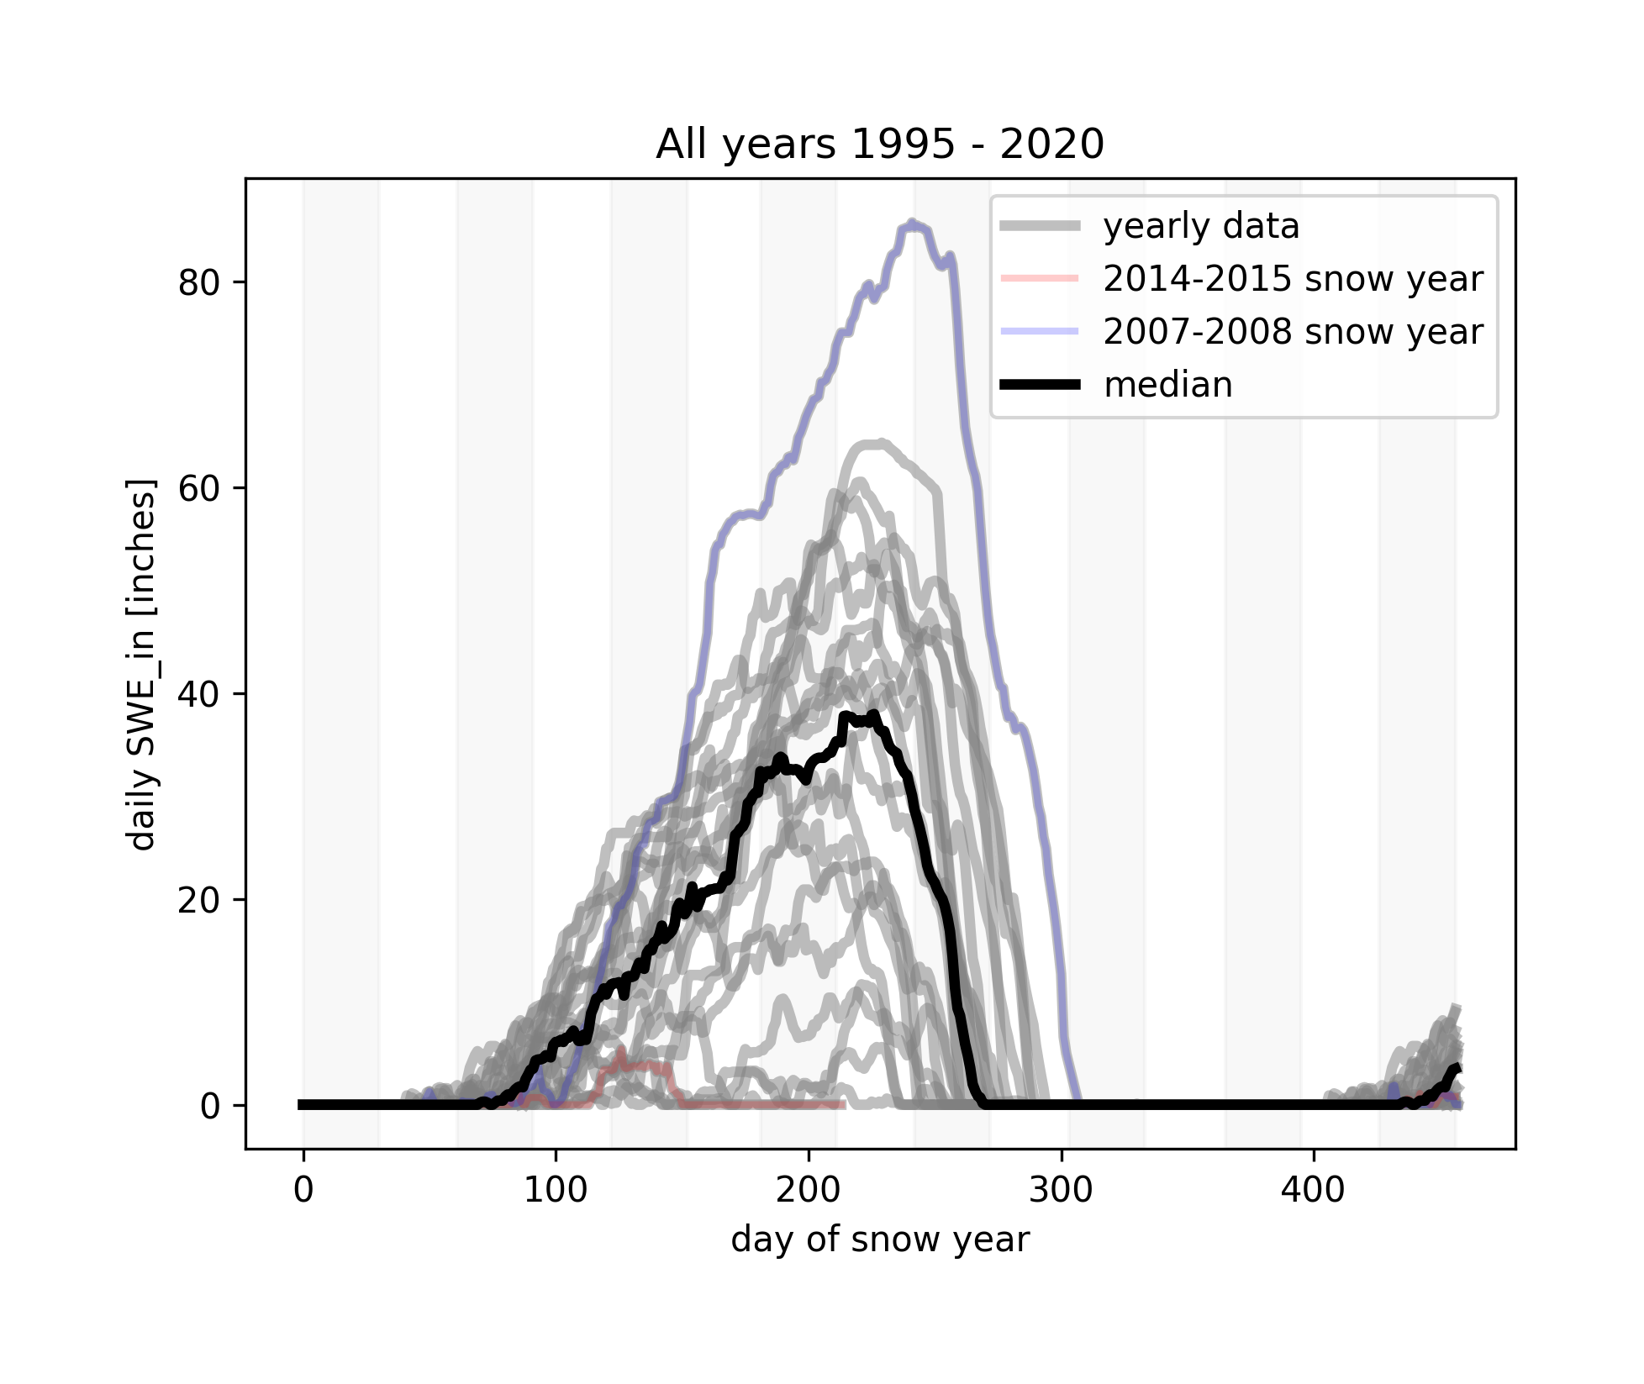
S
O
N
D
J
F
M
A
M
J
J
A
S
O
N
Notes:
python getminmax.py -op minmaxs/09.01.1995-12.01.2020.png -infile_stream /Users/ginevramoore/Desktop/CEWA568/final_project/data/all_data_12147600.csv -infile_snotel ../data/skookum_snotel.csv -b 09.01.1995 12.01.2020 -c1 SWE_in -u1 [inches] -nl y -plothighyear y -plotlowyear y

Slide 25
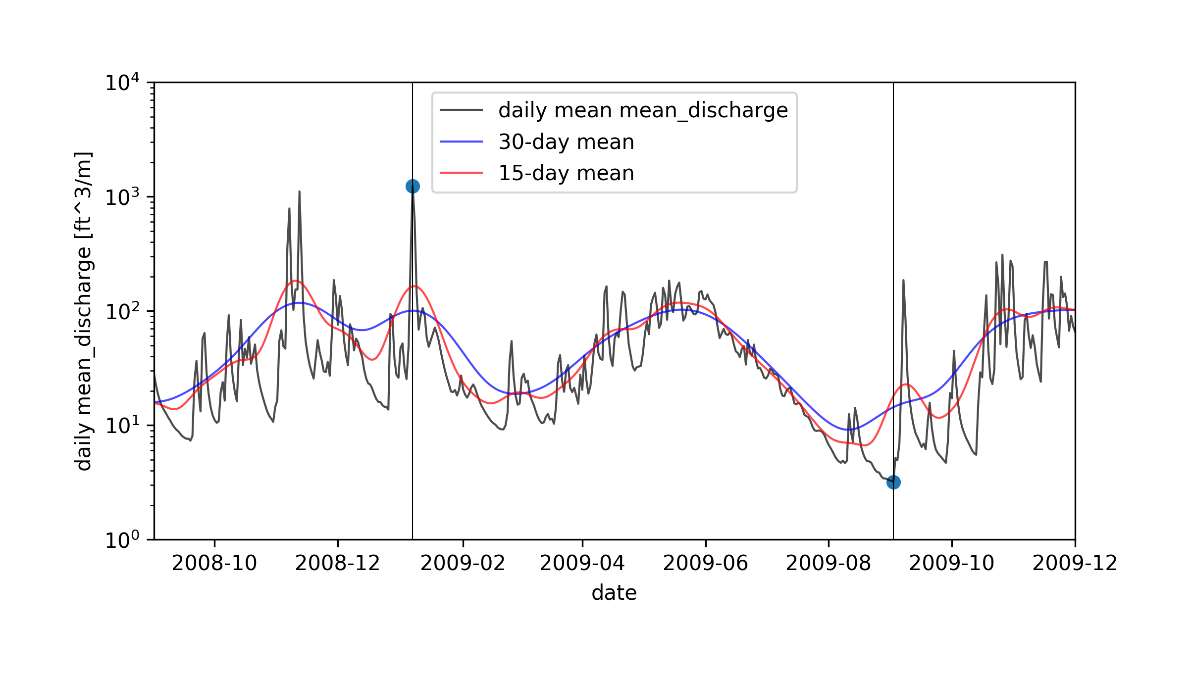
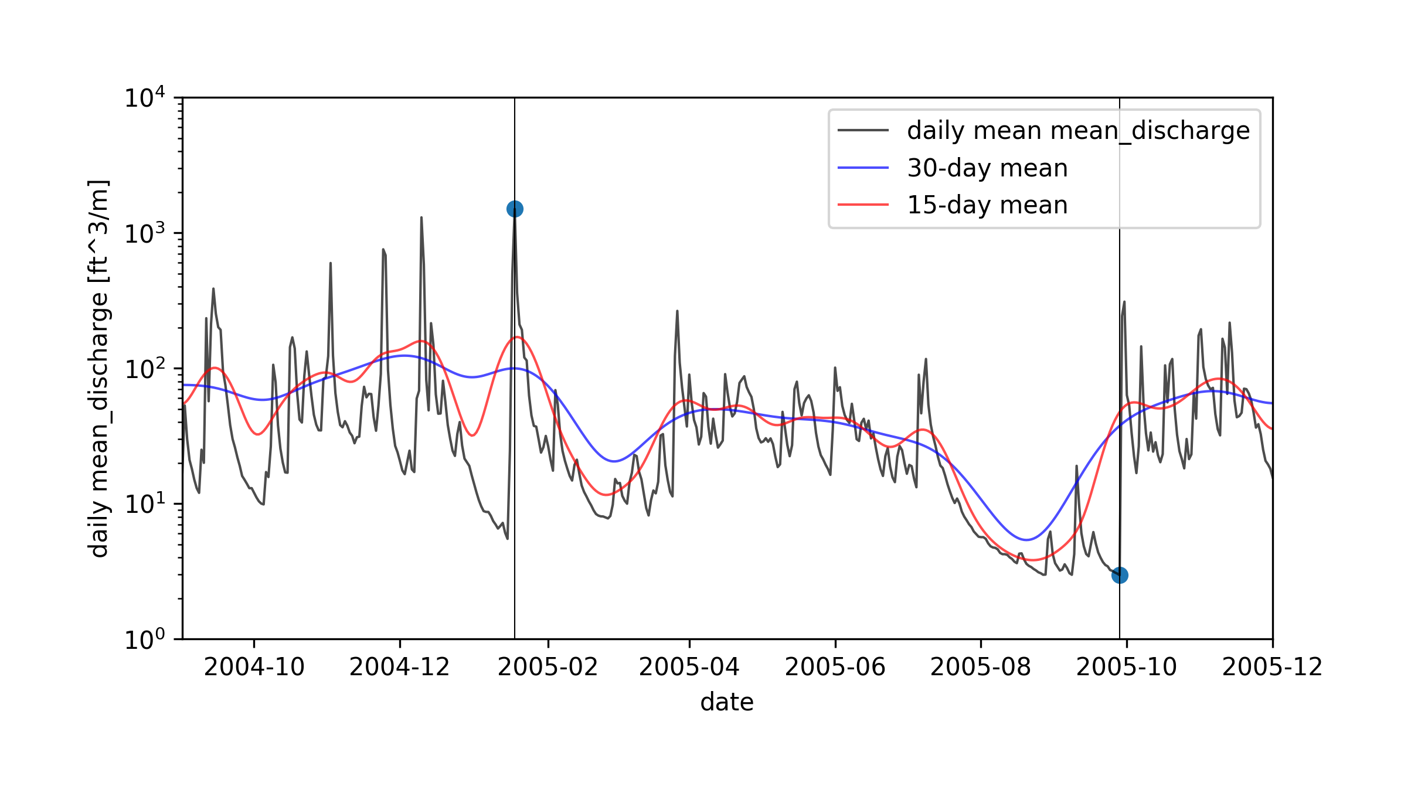
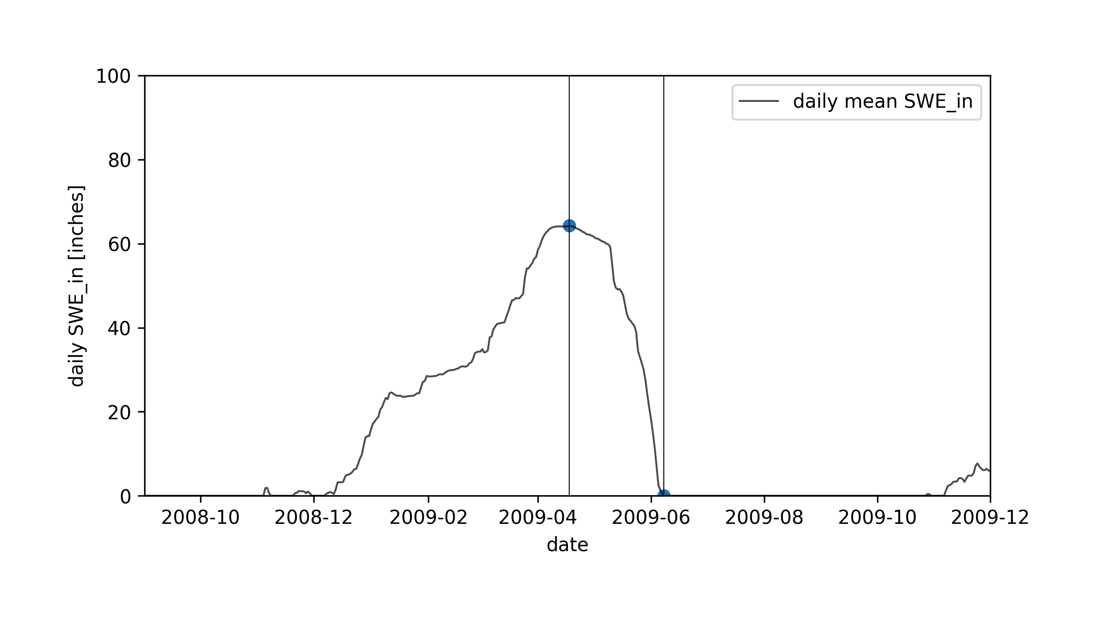
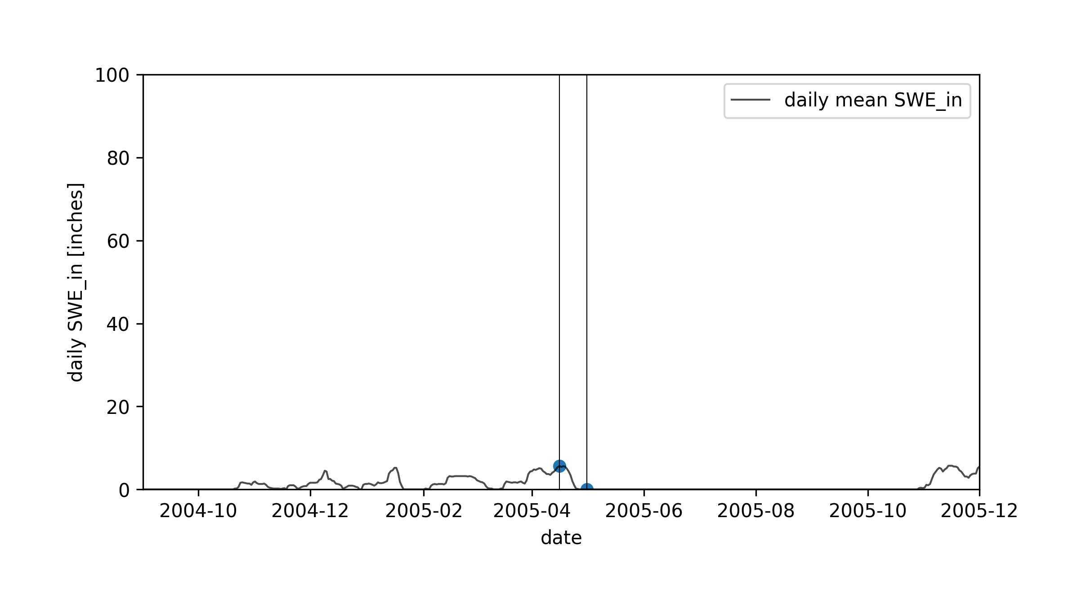
USGS stream gage site no. 12147600
USGS stream gage site no. 12147600
Skookum Creek SNOtel Site
Skookum Creek SNOtel Site
Notes:
python plotyear.py -infile_stream /Users/ginevramoore/Desktop/CEWA568/final_project/data/all_data_12147600.csv -op water_years/12147600_09.01.%s-12.01.%s.png -b 09.01.%s 12.01.%s -p1dm y -p15dm y -p30dm y -c1 mean_discharge -u1 [ft^3/m]

Slide 26
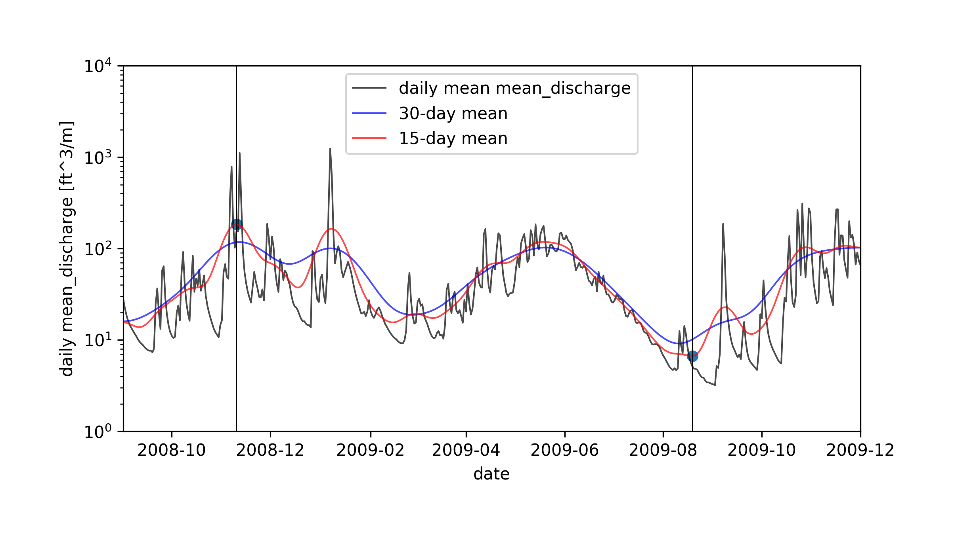
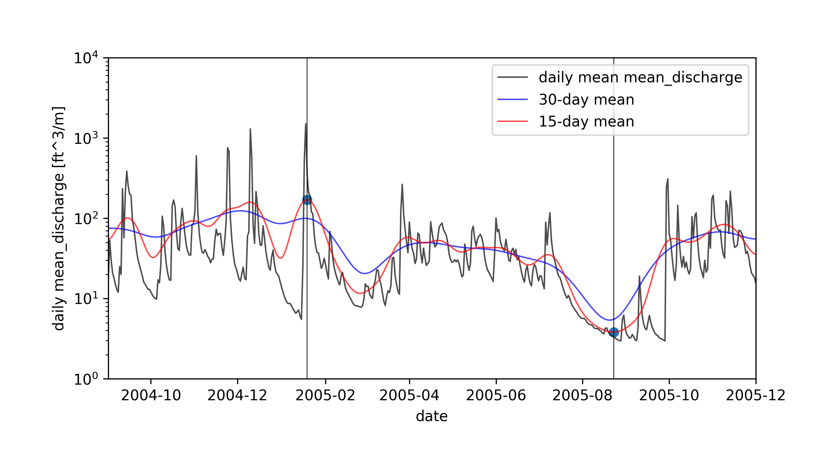
USGS stream gage site no. 12147600
USGS stream gage site no. 12147600
A
B
Skookum Creek SNOTEL Site
Skookum Creek SNOTEL Site
C
D
Mid-winter melt event?
Rain on snow event?
Notes:
python plotyear.py -infile_stream /Users/ginevramoore/Desktop/CEWA568/final_project/data/all_data_12147600.csv -op water_years/12147600_09.01.%s-12.01.%s.png -b 09.01.%s 12.01.%s -p1dm y -p15dm y -p30dm y -c1 mean_discharge -u1 [ft^3/m] -mm 15d

Slide 27
S
O
N
D
J
F
M
A
M
J
J
A
S
O
N
S
O
N
D
J
F
M
A
M
J
J
A
S
O
N
Notes:
python getminmax.py -op minmaxs/09.01.1959-12.01.2020.png -infile_stream /Users/ginevramoore/Desktop/CEWA568/final_project/data/all_data_12147600.csv -infile_snotel ../data/skookum_snotel.csv -b 09.01.1959 12.01.2020 -c1 mean_discharge -u1 [ft^3/m] -plothighyear y
python getminmax.py -op minmaxs/09.01.1995-12.01.2020.png -infile_stream /Users/ginevramoore/Desktop/CEWA568/final_project/data/all_data_12147600.csv -infile_snotel ../data/skookum_snotel.csv -b 09.01.1995 12.01.2020 -c1 SWE_in -u1 [inches] -nl y -plothighyear y

Slide 28
S
O
N
D
J
F
M
A
M
J
J
A
S
O
N
S
O
N
D
J
F
M
A
M
J
J
A
S
O
N
Notes:
python getminmax.py -op minmaxs/09.01.1959-12.01.2020.png -infile_stream /Users/ginevramoore/Desktop/CEWA568/final_project/data/all_data_12147600.csv -infile_snotel ../data/skookum_snotel.csv -b 09.01.1959 12.01.2020 -c1 mean_discharge -u1 [ft^3/m] -plothighyear y
python getminmax.py -op minmaxs/09.01.1995-12.01.2020.png -infile_stream /Users/ginevramoore/Desktop/CEWA568/final_project/data/all_data_12147600.csv -infile_snotel ../data/skookum_snotel.csv -b 09.01.1995 12.01.2020 -c1 SWE_in -u1 [inches] -nl y -plothighyear y

Slide 29
S
O
N
D
J
F
M
A
M
J
J
A
S
O
N
S
O
N
D
J
F
M
A
M
J
J
A
S
O
N
Notes:
python getminmax.py -op minmaxs/09.01.1959-12.01.2020.png -infile_stream /Users/ginevramoore/Desktop/CEWA568/final_project/data/all_data_12147600.csv -infile_snotel ../data/skookum_snotel.csv -b 09.01.1959 12.01.2020 -c1 mean_discharge -u1 [ft^3/m] -plothighyear y -plotlowyear y
python getminmax.py -op minmaxs/09.01.1995-12.01.2020.png -infile_stream /Users/ginevramoore/Desktop/CEWA568/final_project/data/all_data_12147600.csv -infile_snotel ../data/skookum_snotel.csv -b 09.01.1995 12.01.2020 -c1 SWE_in -u1 [inches] -nl y -plothighyear y -plotlowyear y

Slide 30
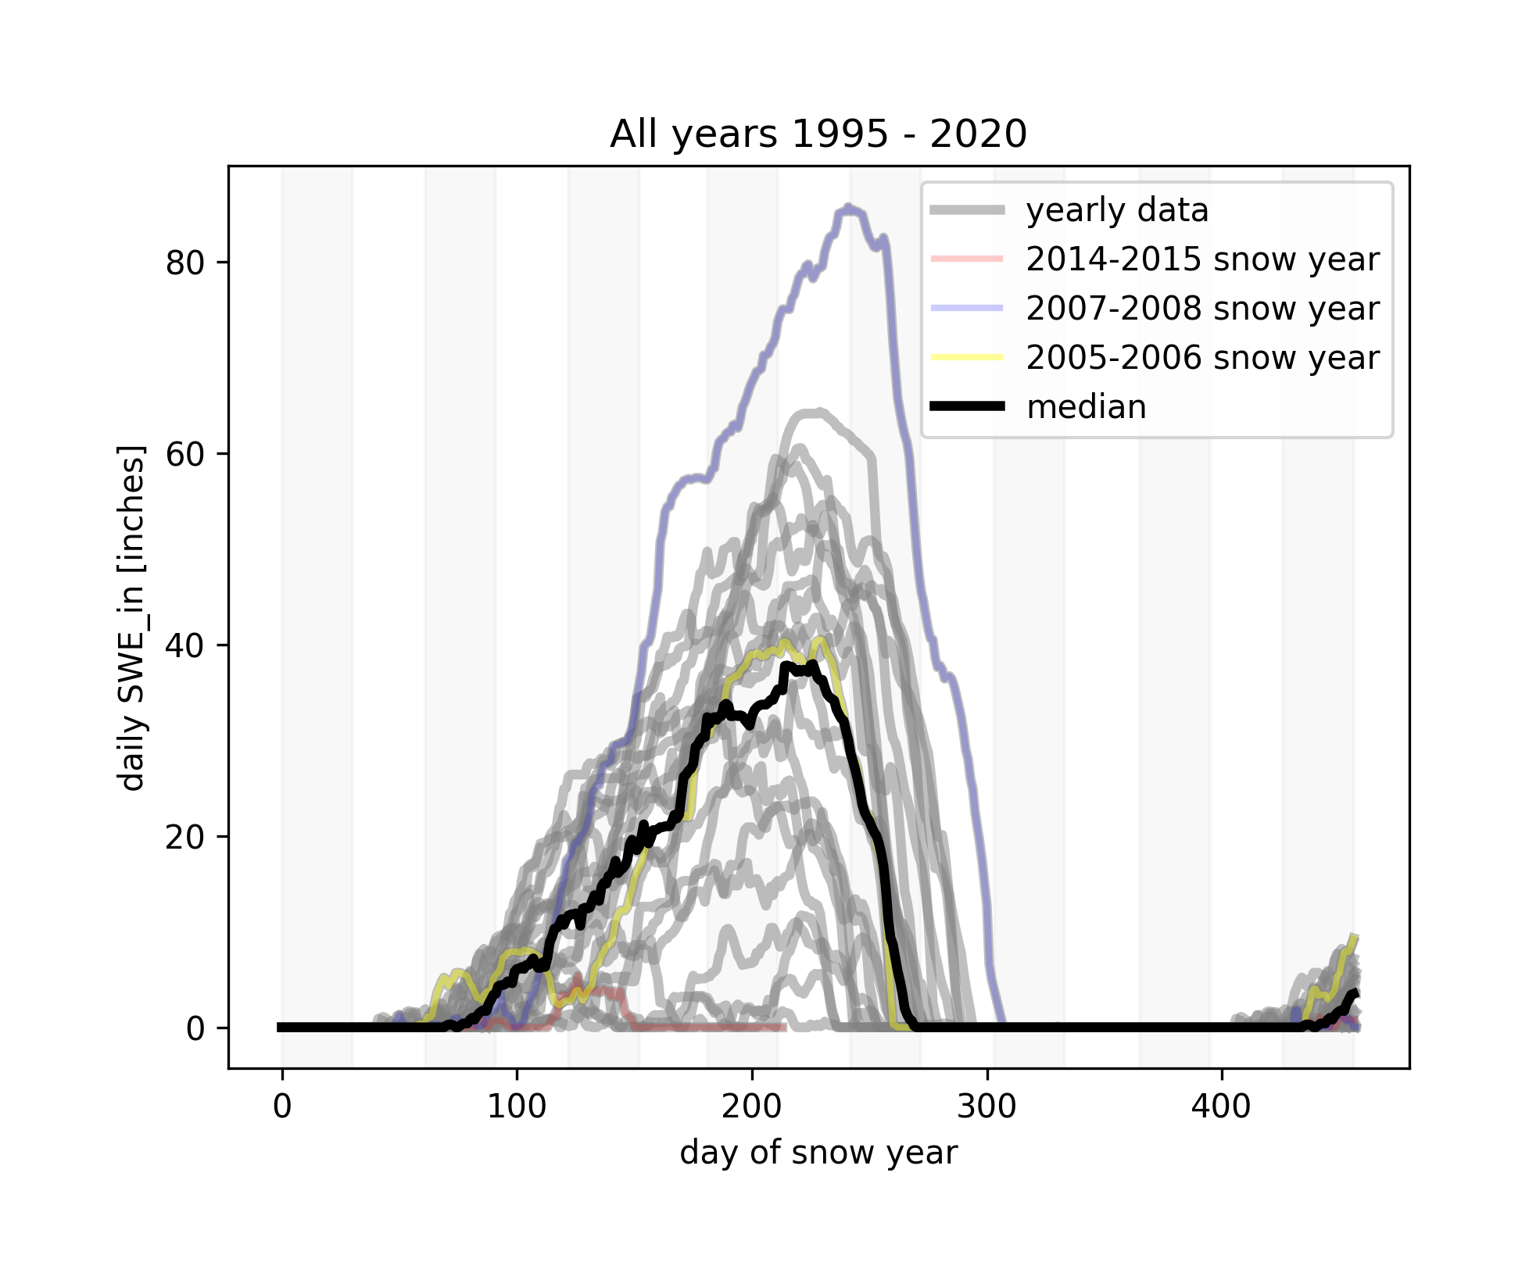
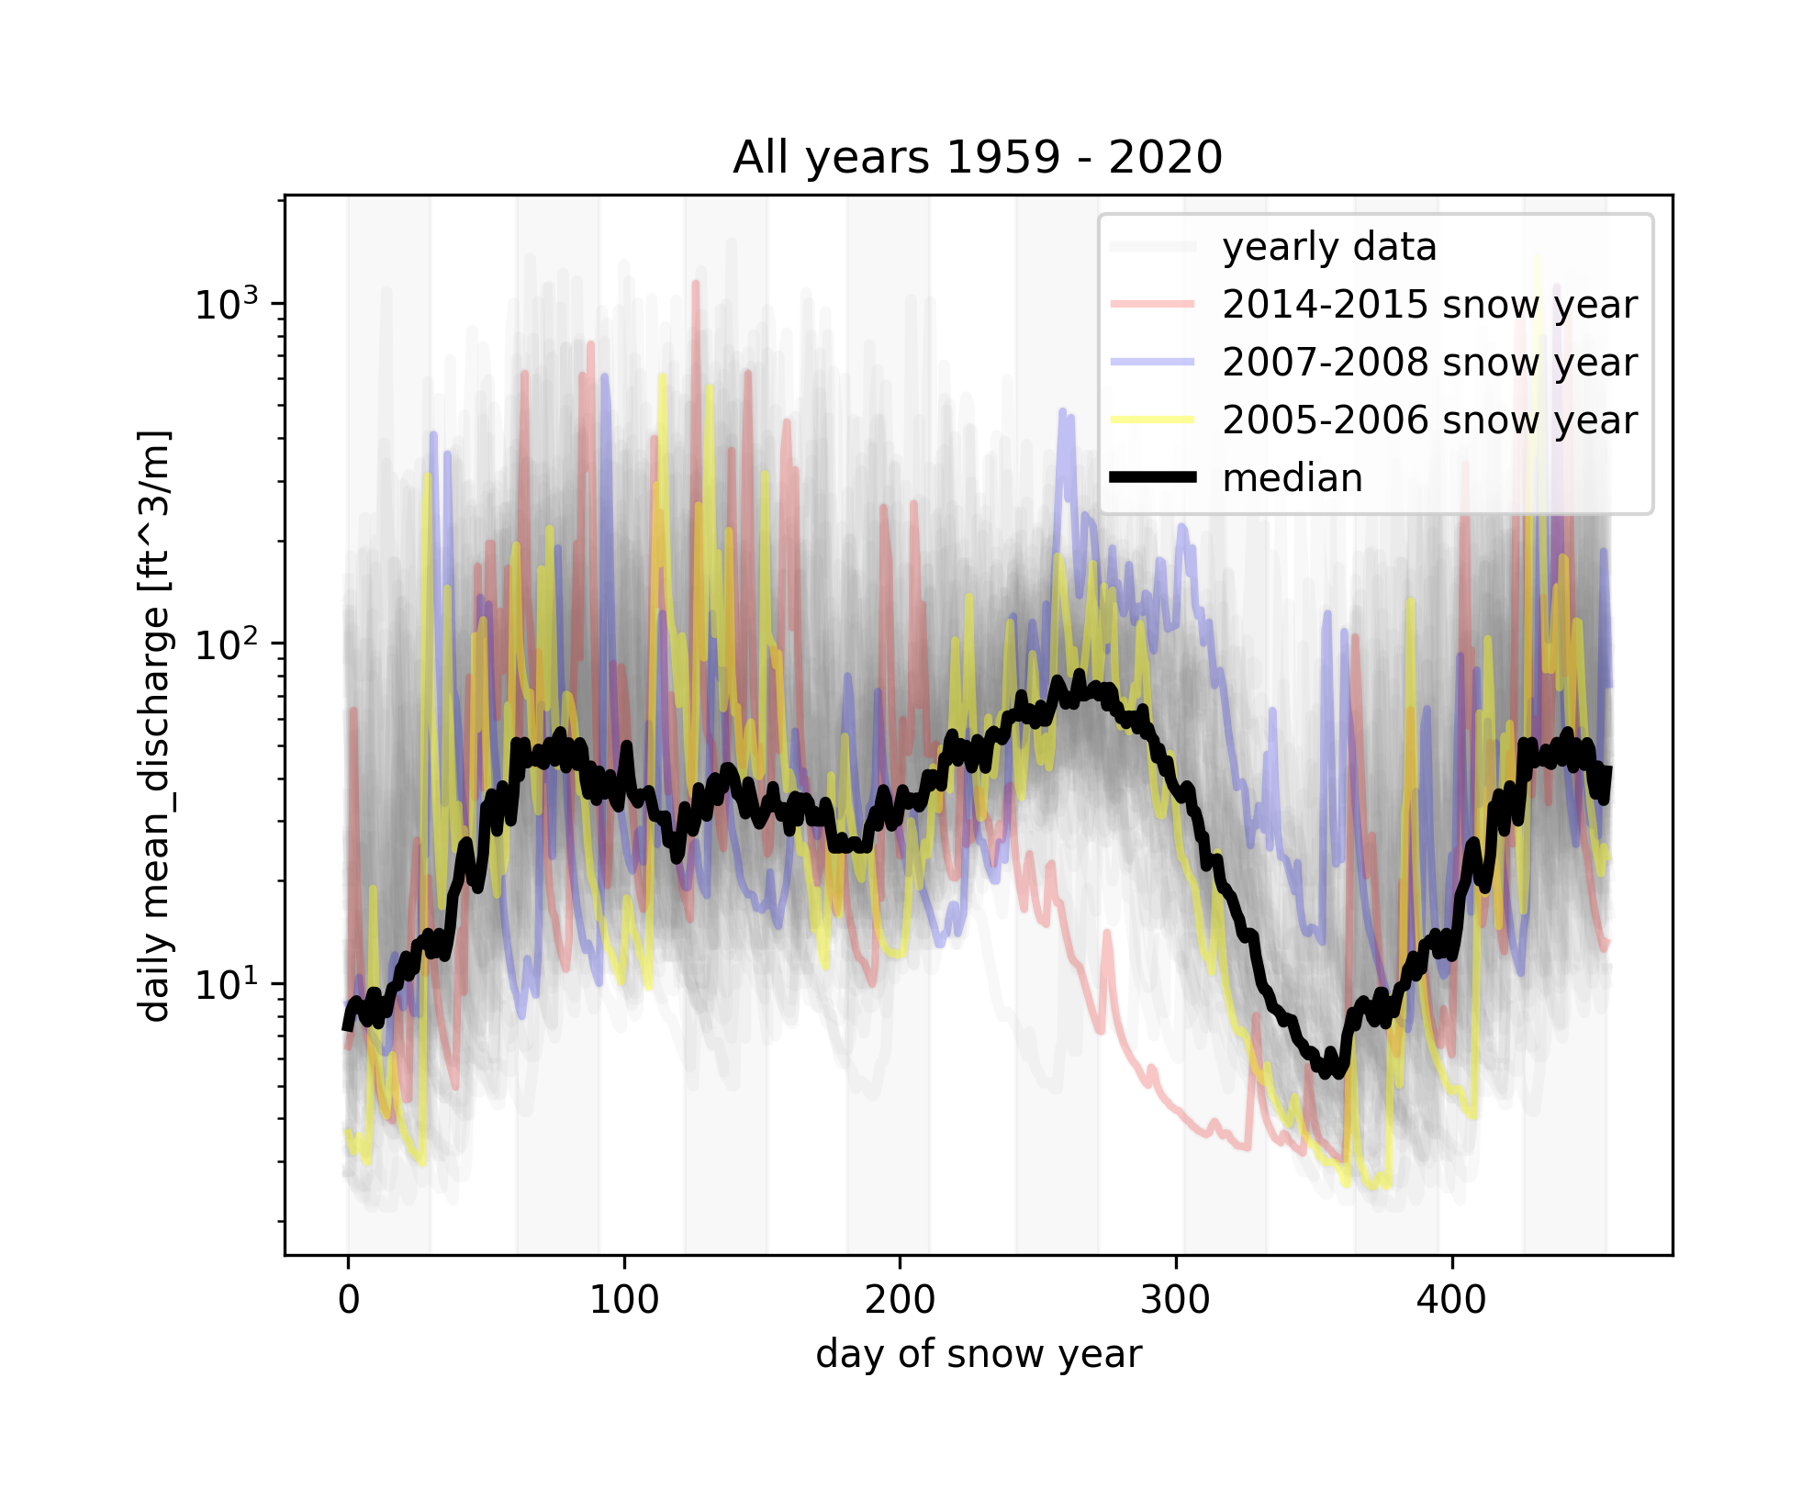
S
O
N
D
J
F
M
A
M
J
J
A
S
O
N
S
O
N
D
J
F
M
A
M
J
J
A
S
O
N
Notes:
python getminmax.py -op minmaxs/09.01.1959-12.01.2020.png -infile_stream /Users/ginevramoore/Desktop/CEWA568/final_project/data/all_data_12147600.csv -infile_snotel ../data/skookum_snotel.csv -b 09.01.1959 12.01.2020 -c1 mean_discharge -u1 [ft^3/m] -plothighyear y -plotlowyear y -plotmedyear y
python getminmax.py -op minmaxs/09.01.1995-12.01.2020.png -infile_stream /Users/ginevramoore/Desktop/CEWA568/final_project/data/all_data_12147600.csv -infile_snotel ../data/skookum_snotel.csv -b 09.01.1995 12.01.2020 -c1 SWE_in -u1 [inches] -nl y -plothighyear y -plotlowyear y -plotmedyear y

Slide 31
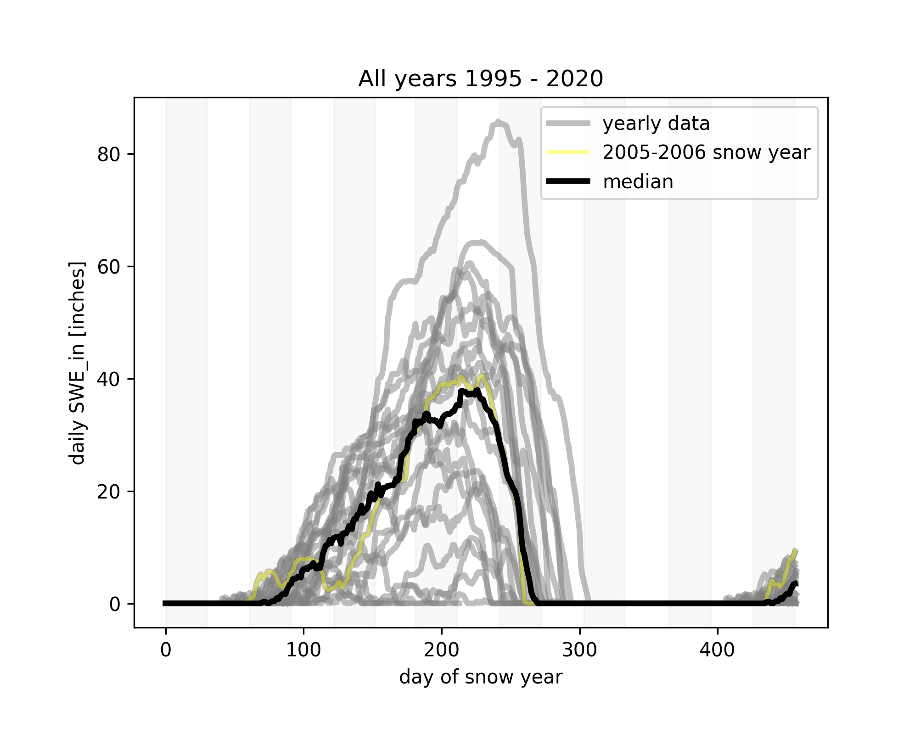
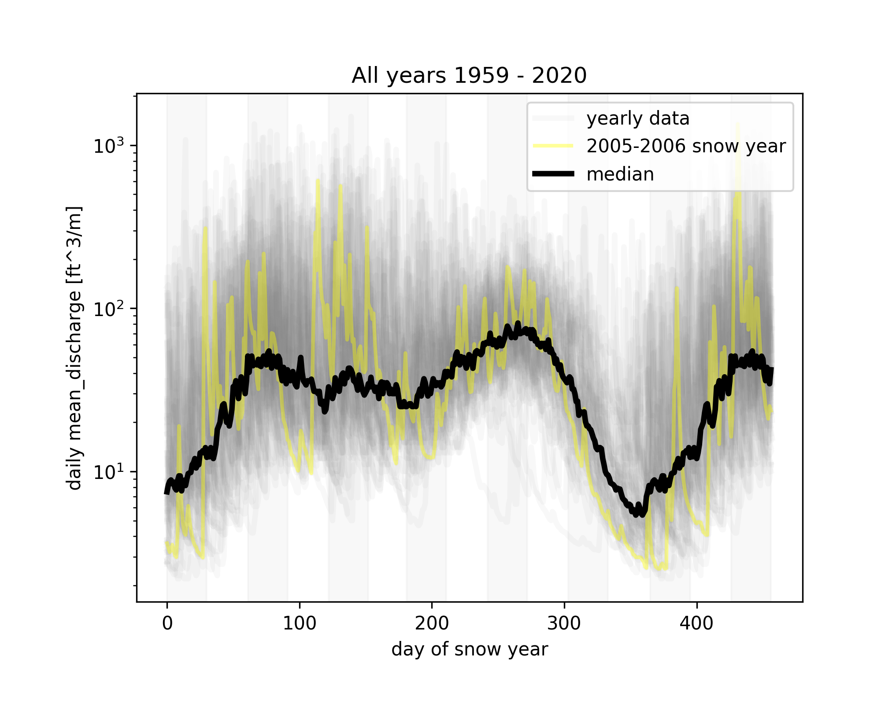
S
O
N
D
J
F
M
A
M
J
J
A
S
O
N
S
O
N
D
J
F
M
A
M
J
J
A
S
O
N
Notes:
python getminmax.py -op minmaxs/09.01.1959-12.01.2020.png -infile_stream /Users/ginevramoore/Desktop/CEWA568/final_project/data/all_data_12147600.csv -infile_snotel ../data/skookum_snotel.csv -b 09.01.1959 12.01.2020 -c1 mean_discharge -u1 [ft^3/m] -plotmedyear y
python getminmax.py -op minmaxs/09.01.1995-12.01.2020.png -infile_stream /Users/ginevramoore/Desktop/CEWA568/final_project/data/all_data_12147600.csv -infile_snotel ../data/skookum_snotel.csv -b 09.01.1995 12.01.2020 -c1 SWE_in -u1 [inches] -nl y -plotmedyear y

Slide 32
areas
Whole upper south fork tolt river basin
﻿ ﻿48.75000000000
﻿13.561506

